Slide 1
Geography of the USA
Five big lakes in the north of the USA.
The largest city in the USA.
The biggest river of the USA.
The chain of mountains in the east of the USA.
The chain of mountains in the west of the USA.
The plains which are situated in the central part of the USA.
The capital of the USA.
The biggest state of the USA

Slide 2
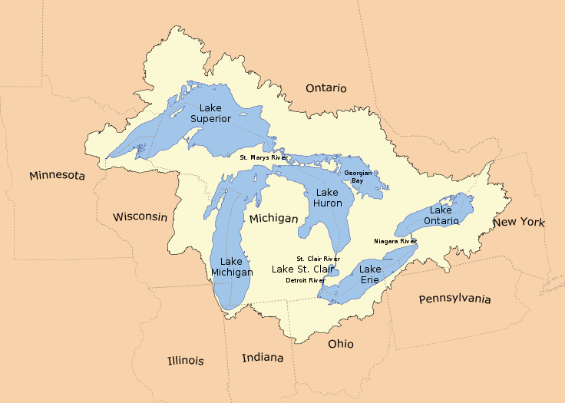
The Great Lakes

Slide 3
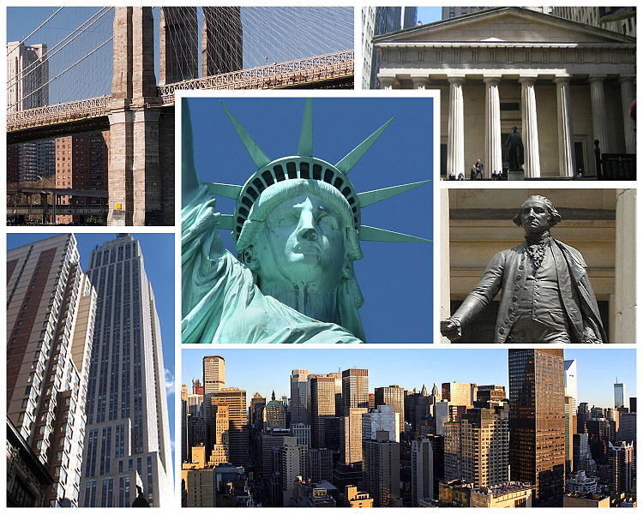
New York

Slide 4
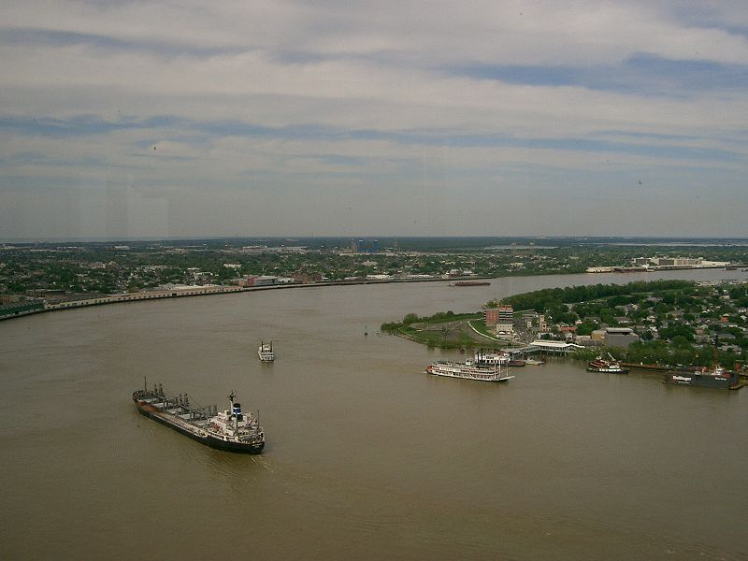
The Mississippi River

Slide 5
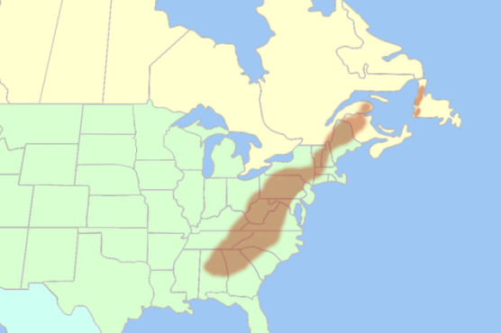
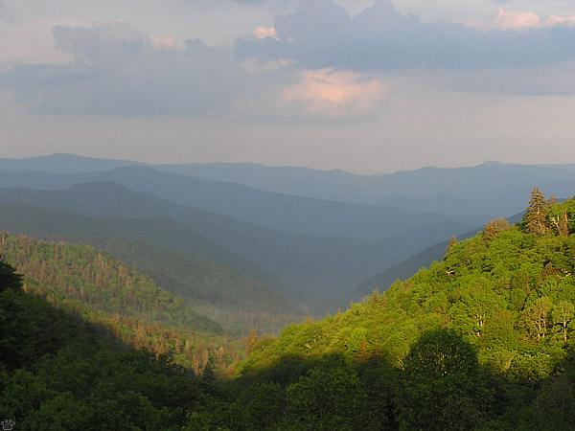
The Appalachians

Slide 6
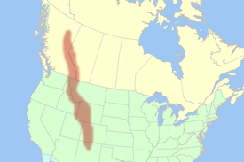
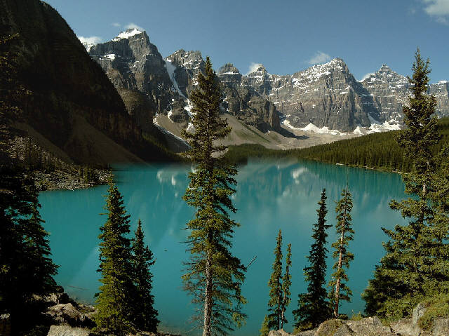
The Rocky Mountains

Slide 7
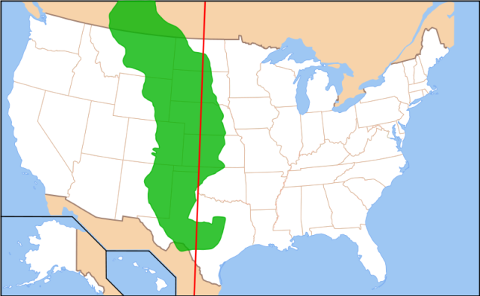
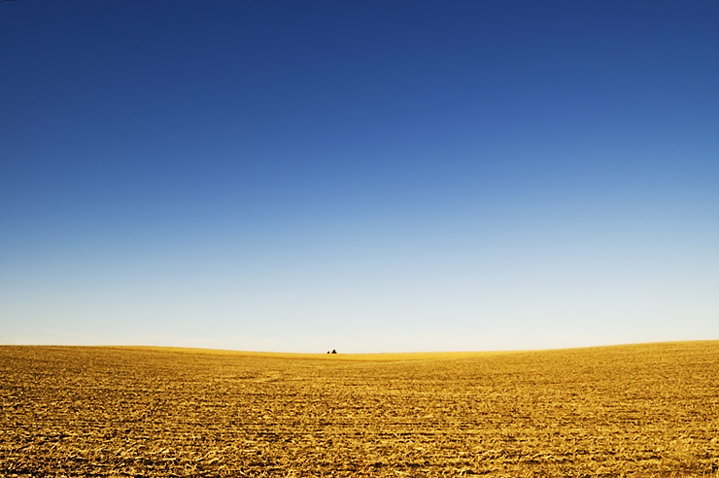
The Great Plains

Slide 8
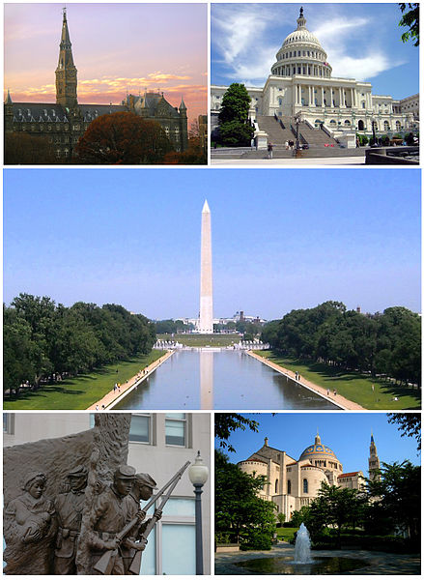
Washington, D.C.

Slide 9
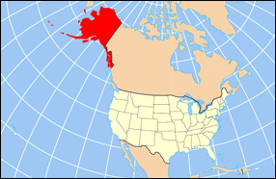
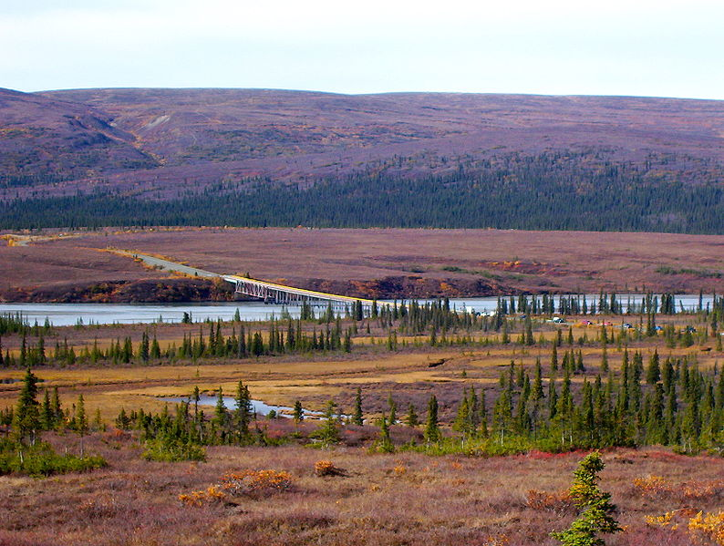
Alaska

