Slide 1
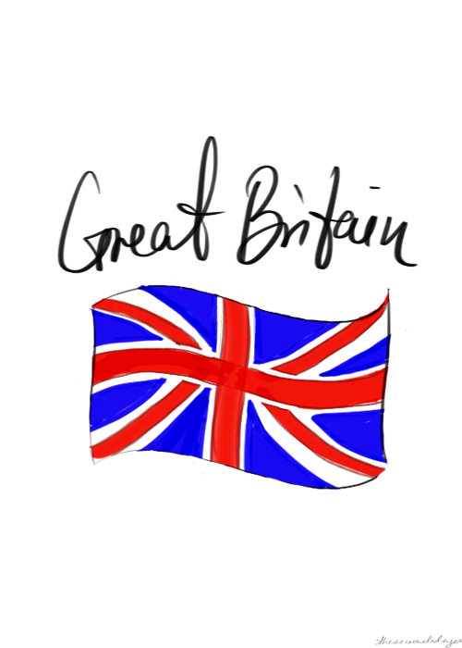
Aneta Hejnová
CR4 2018 / 19

Slide 2
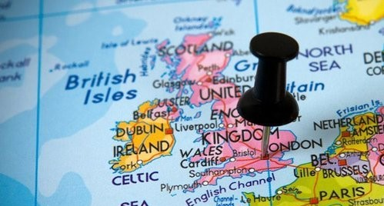
Location
The United Kingdom of Great Britain and Northern Ireland lies off the north-west coast of Europe across the English Channel between the North sea and Atlantic ocean.
It consists of two large islands and about 5 000 smaller ones.
The island is dominated by a maritime climate.
A large island in the North Atlantic Ocean.

Slide 3
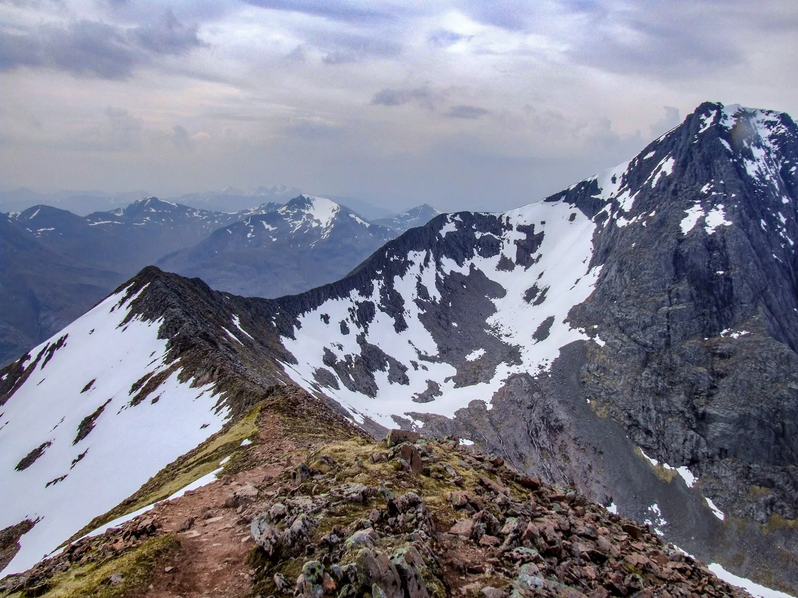
Geography
England is mostly rolling land.
The main mountain regions - Cornish Heights, the Cambrians, the Pennines and the Cumbrian Mountains
The highest mountain is Ben Nevis.
The longest rivers are the Severn and the Thames.

Slide 4
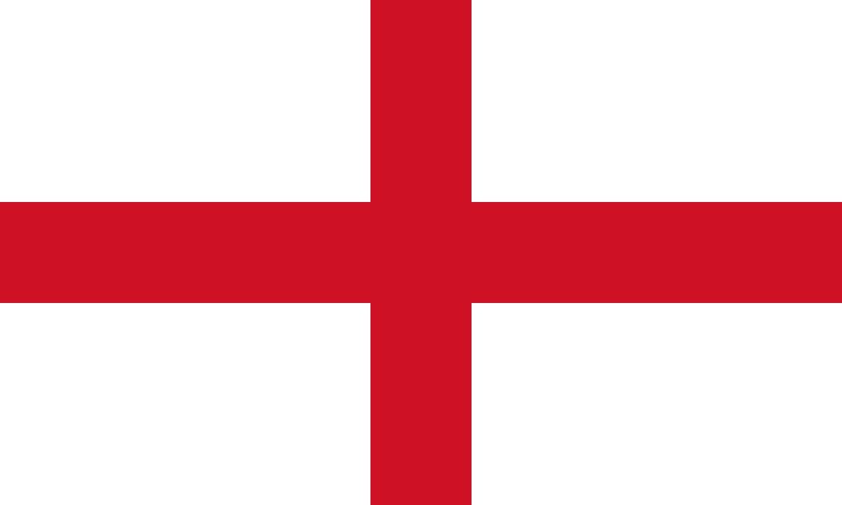
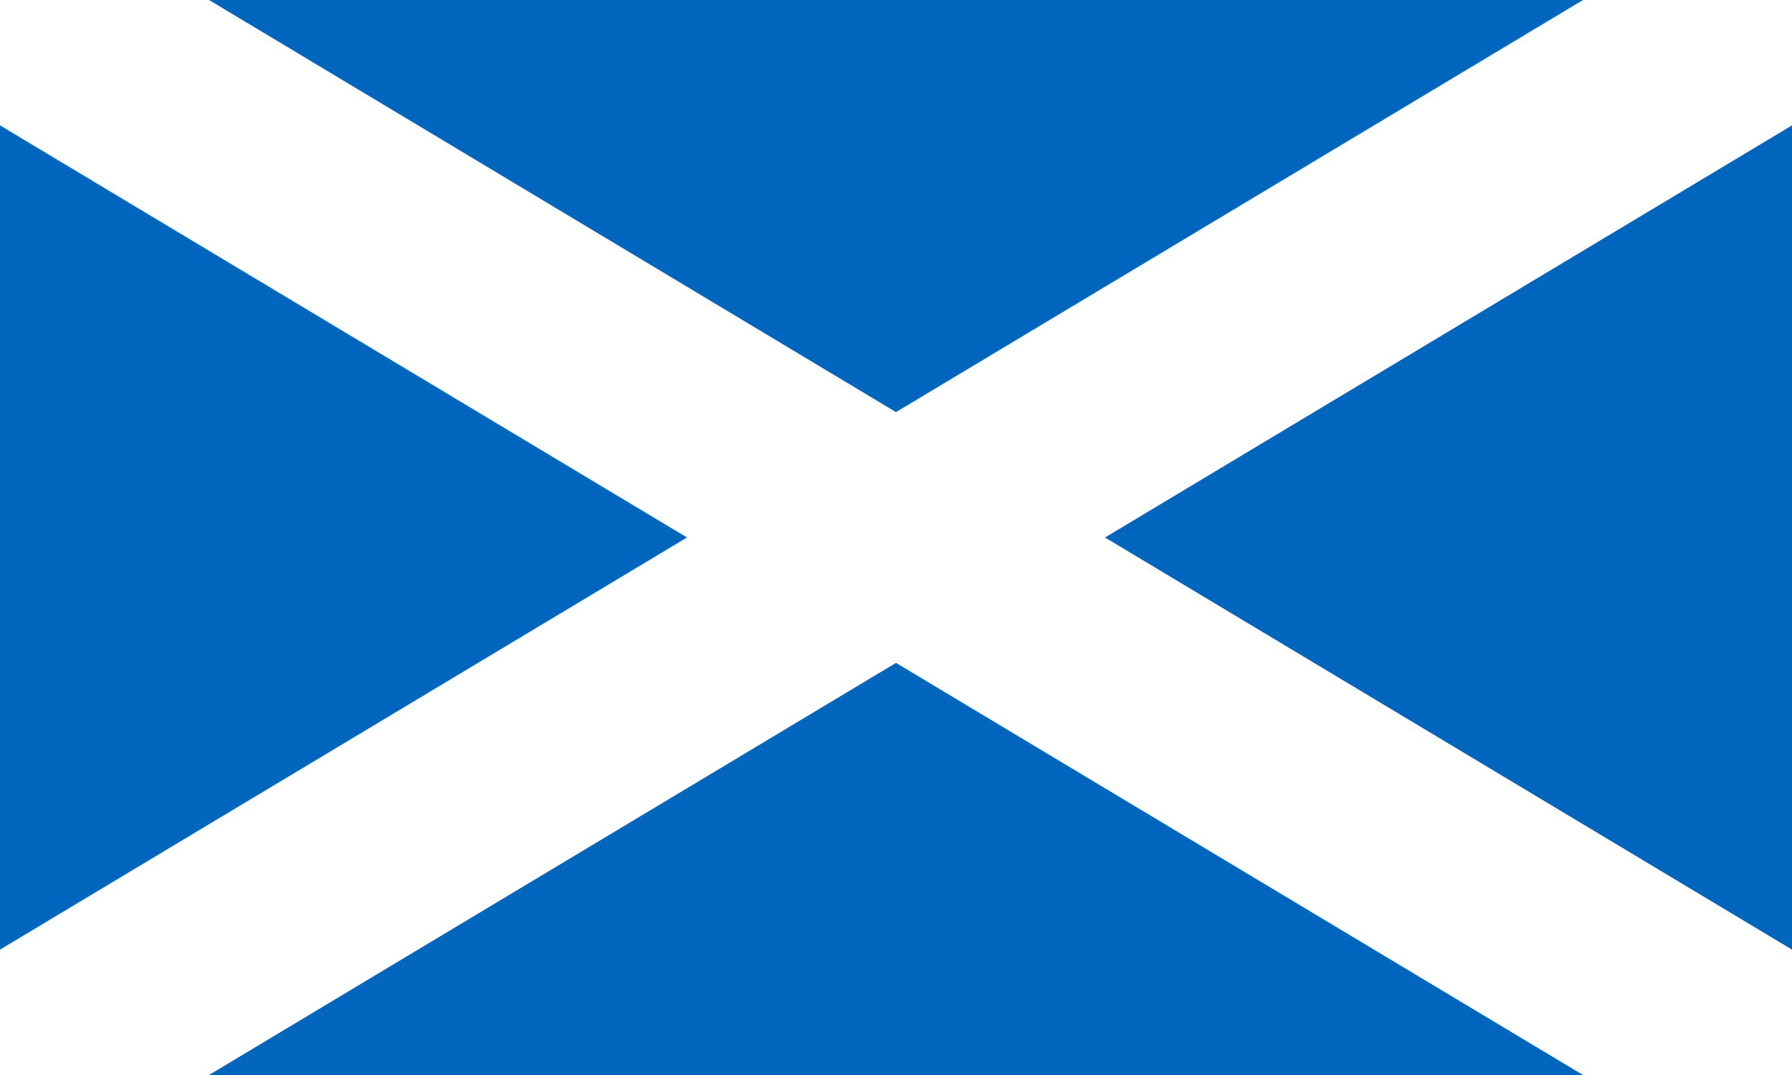
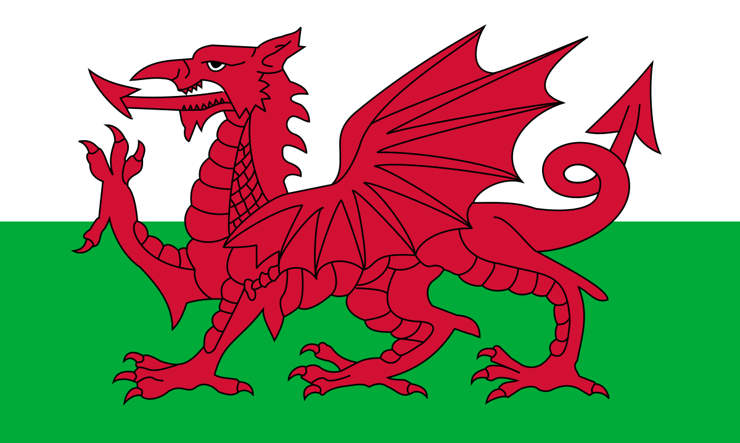
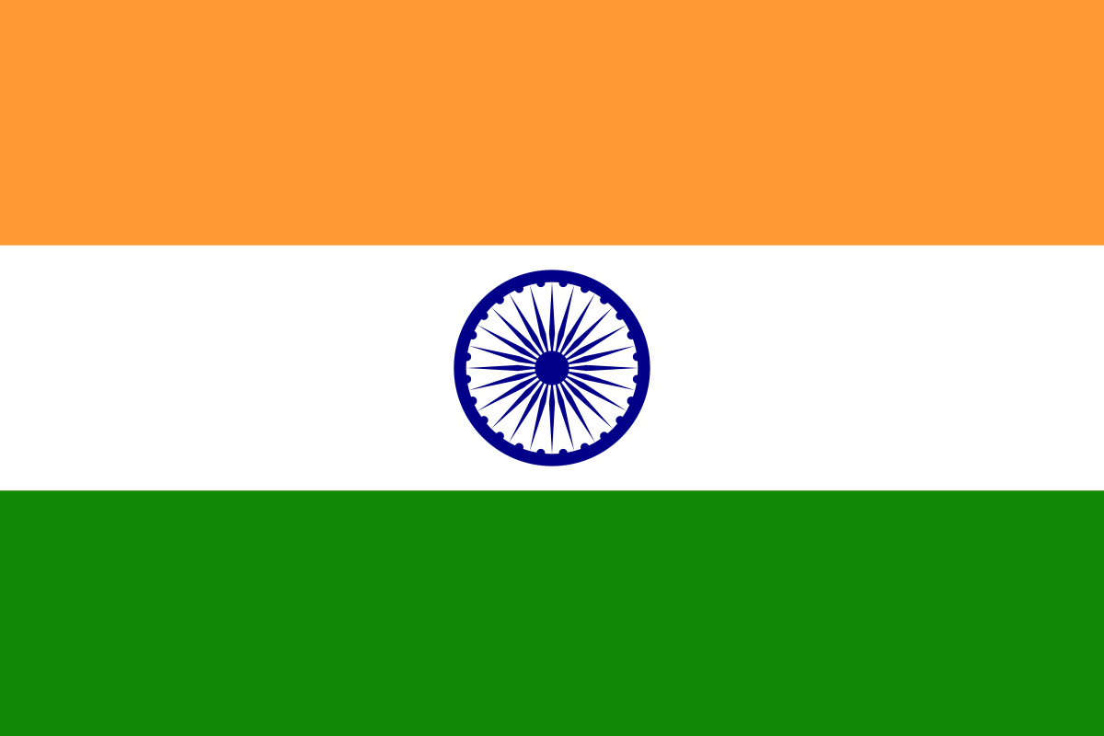
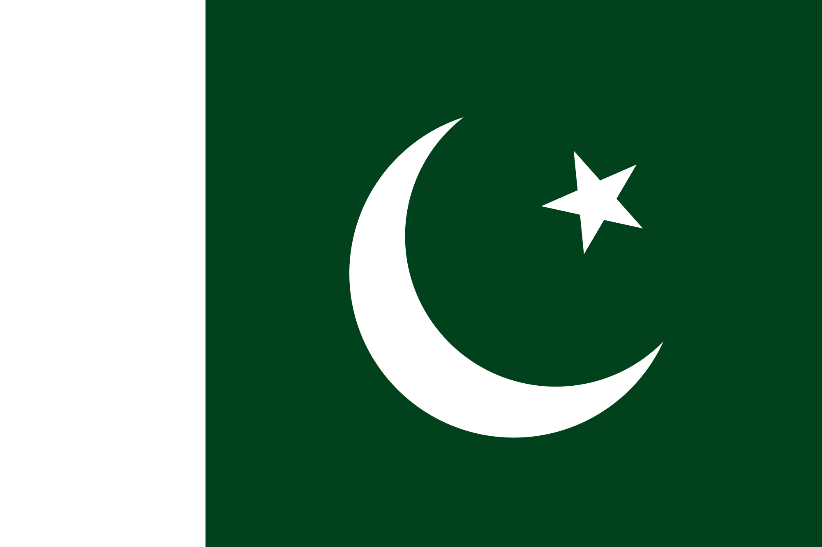
People, languages
The population is about 60 million.
Ethnic groups: English, Scottish, Irish, Welsh, Indian, Pakistan and others.
The main language is English.

Slide 5
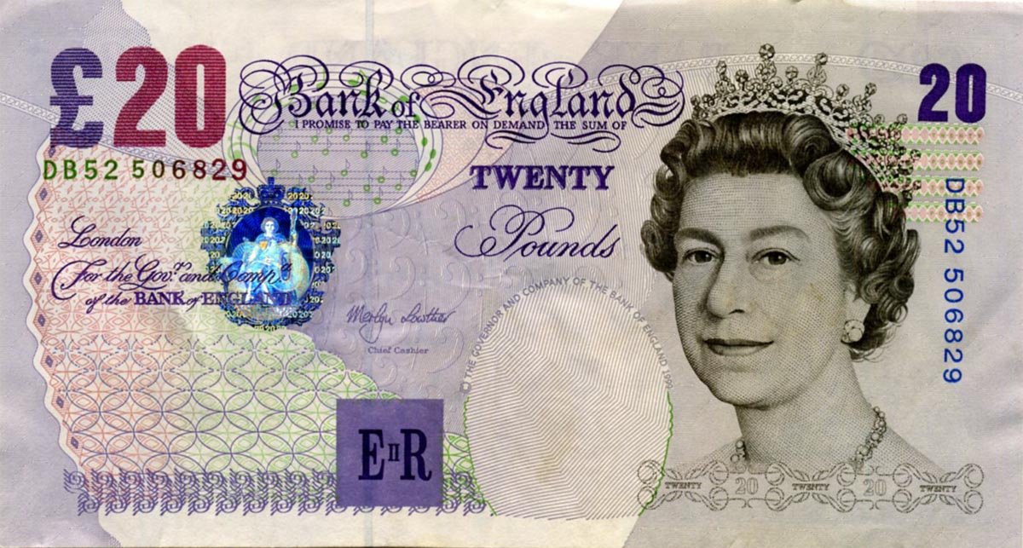
Political system, the capital, currency
A constitutional monarchy with the Queen.
The present Queen is Elizabeth II.
Her powers are limited by constitution.
Britain is divided into four parts: England, Wales, Scotland and Northern Ireland.
Currency – pound.

Slide 6
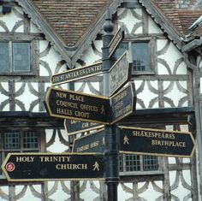
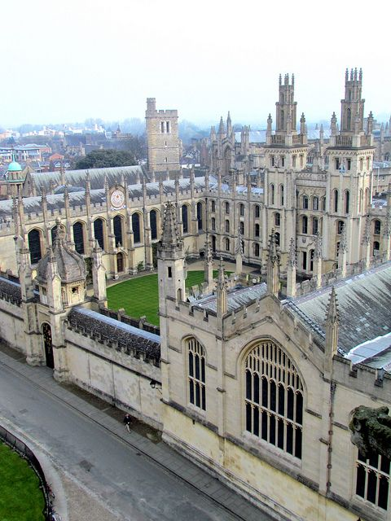
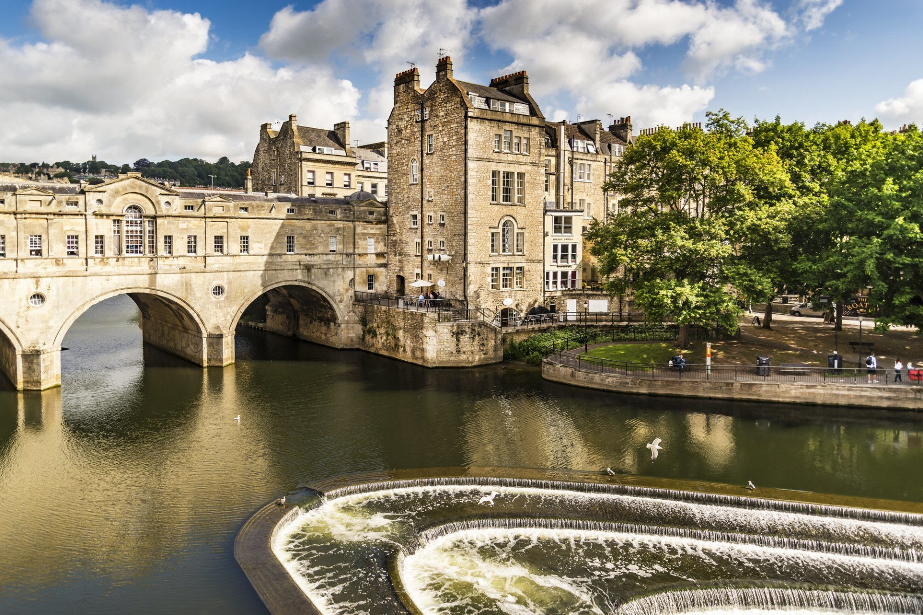
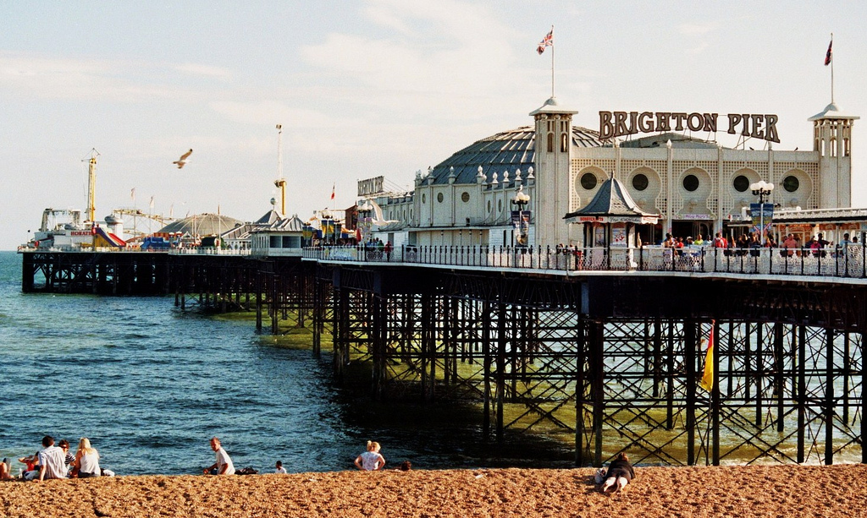
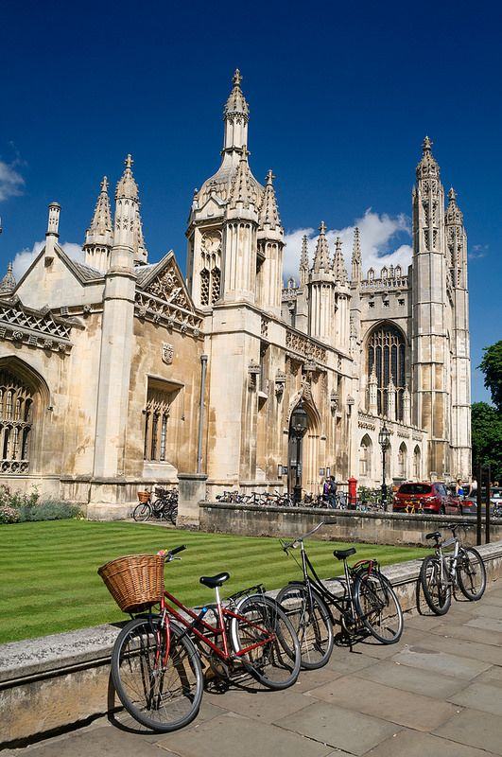
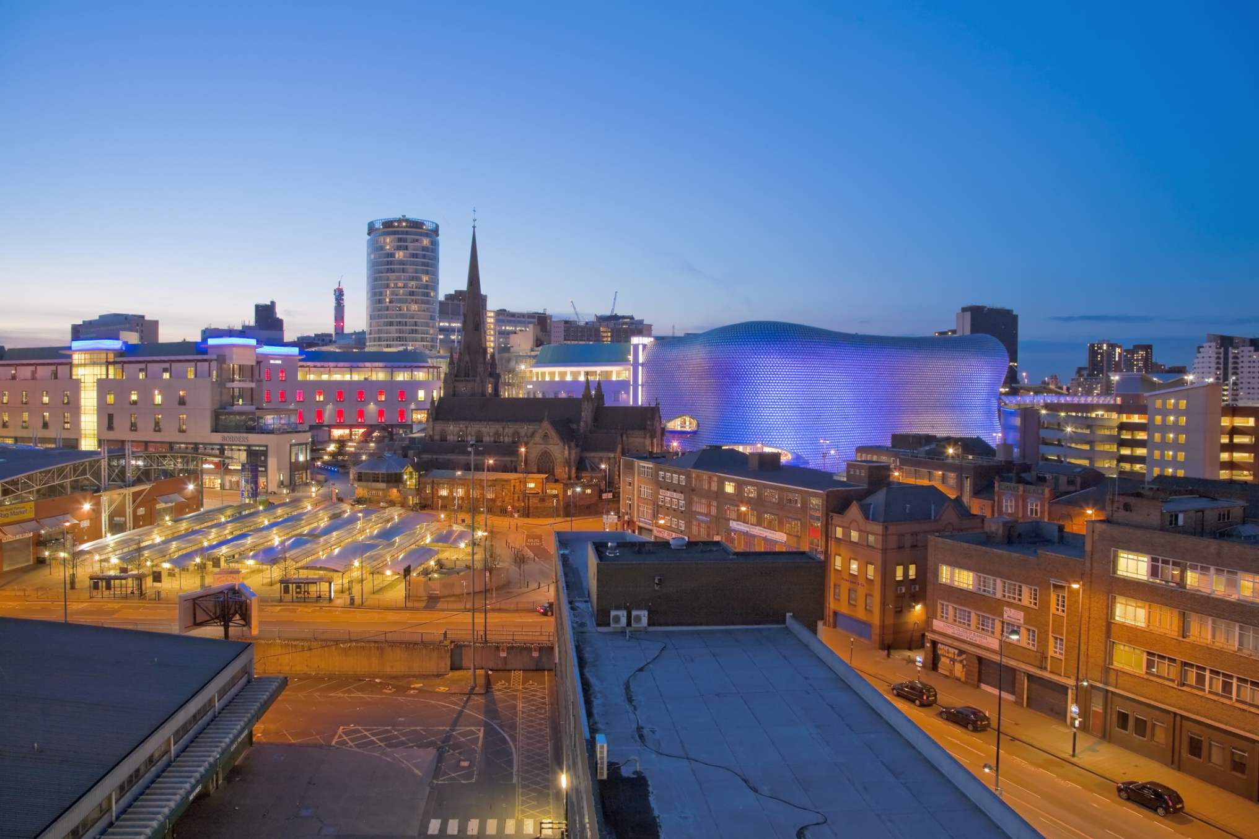
Places of interest
Oxford and Cambridge
Stratford-upon-Avon
Brighton
Manchester
Liverpool
Sheffield
York
Birmingham
Bath
Wales
Scotland (Glasgow)

Slide 7
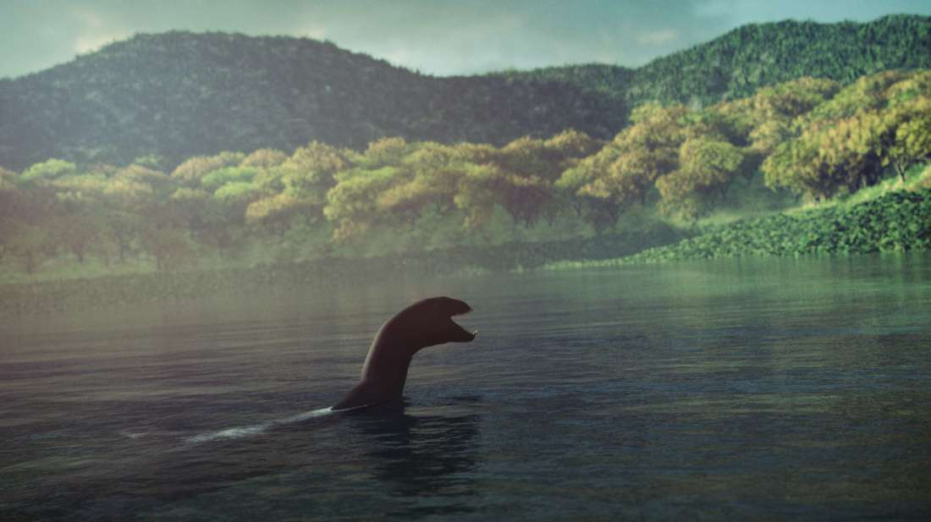
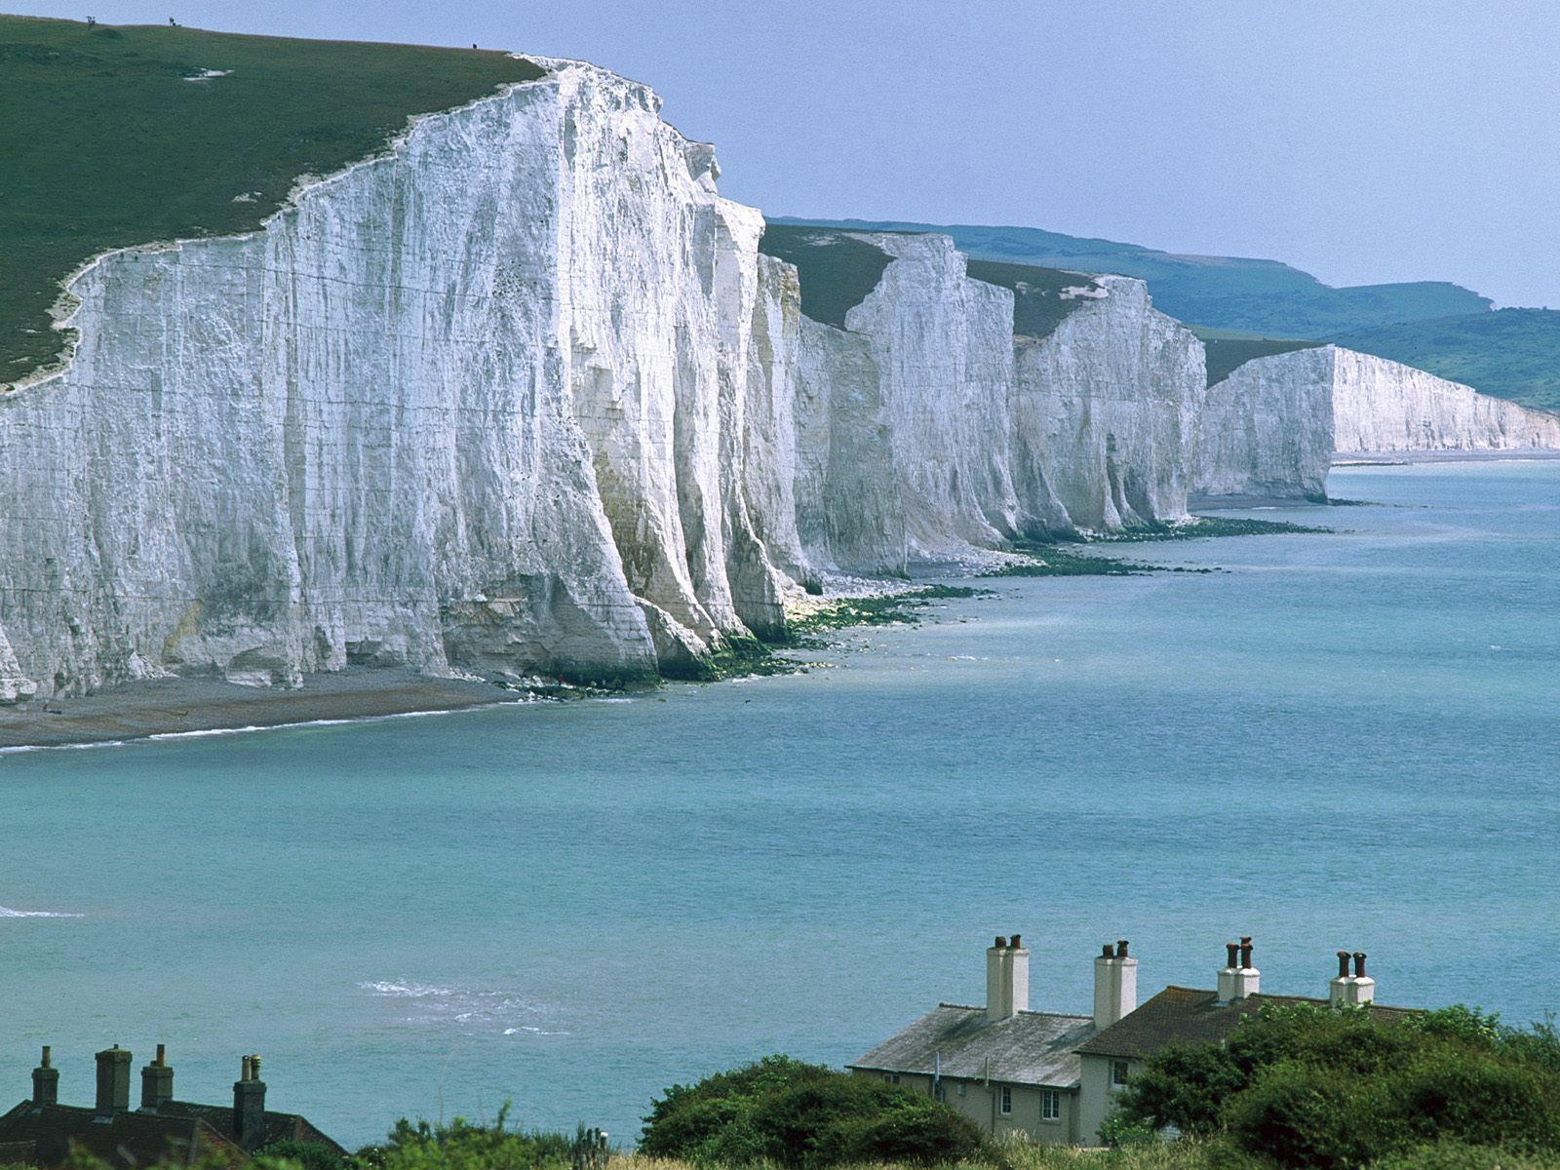
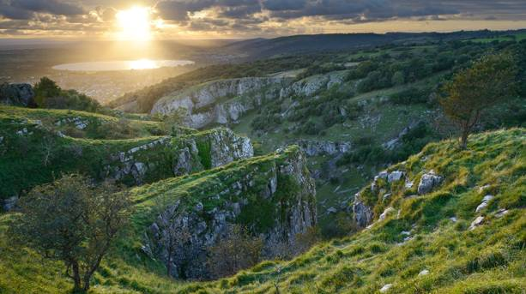
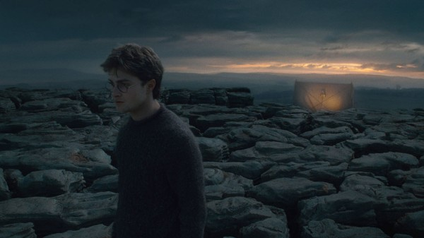
Natural wonders
Seven Sisters cliffs, Sussex, England
Malham Cove, North Yorkshire, England
Cheddar Gorge, Somerset, England
Loch Ness, North Scotland

Slide 8
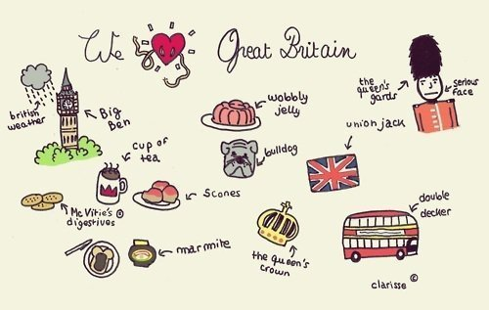
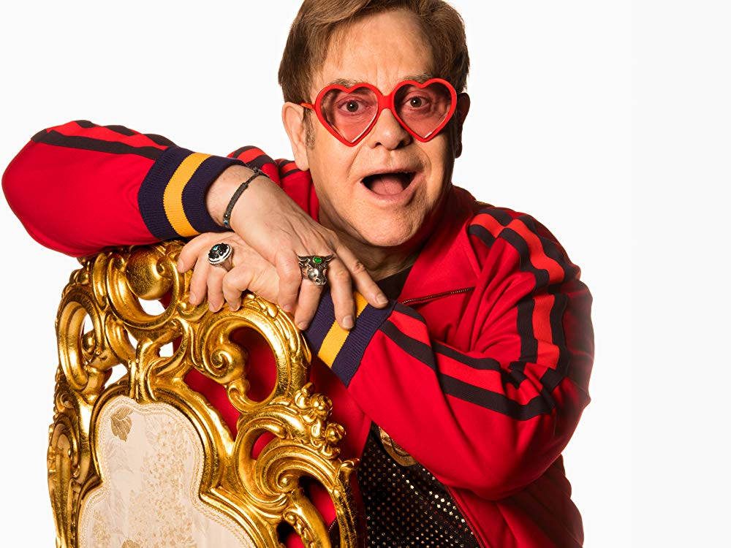
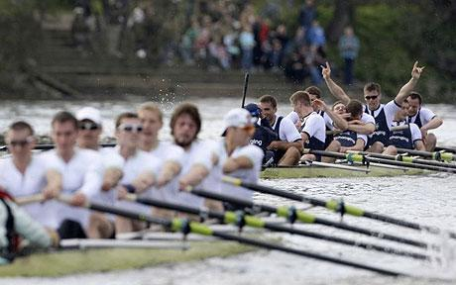
Sports, food, famous people
Sports: cricket, football (soccer), rugby, tennis, golf, university boat race
Food: fish and chips, pizza, roast dinner, bread and butter pudding, typical english breakfast
Famous people: Elizabeth II., Winston Churchill, Margaret Thatcher, Elton John, Paul McCartney, Ed Sheeran, etc.

