Slide 1



Slide 2

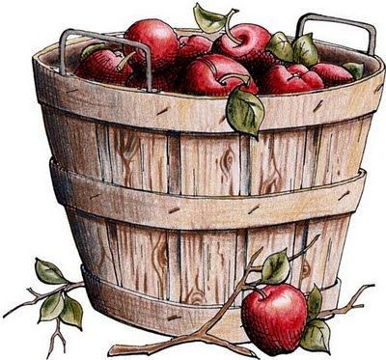
healthy eating
eat six small meals and a big breakfast everyday
drink up to 3 liters of water each day
eat slowly, don‘t starve yourself!
and, of course, eat more fruits/vegetables

Slide 3

basic tips for healthy living
eat healthy
drink plenty of water
sleep 8 hours
exercise
and
try to think positive ;)

Slide 4

exercise
walk daily
focus on fun
be consistent
exercising helps you to stay
focused, improves your mood
and reduces depression,
stress and anxiety~

Slide 5
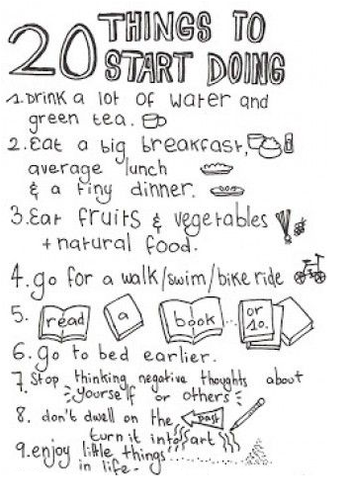
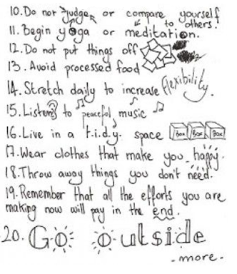

Slide 6


Slide 7
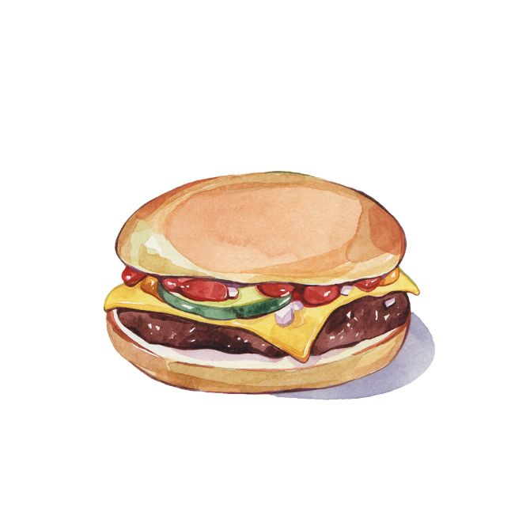
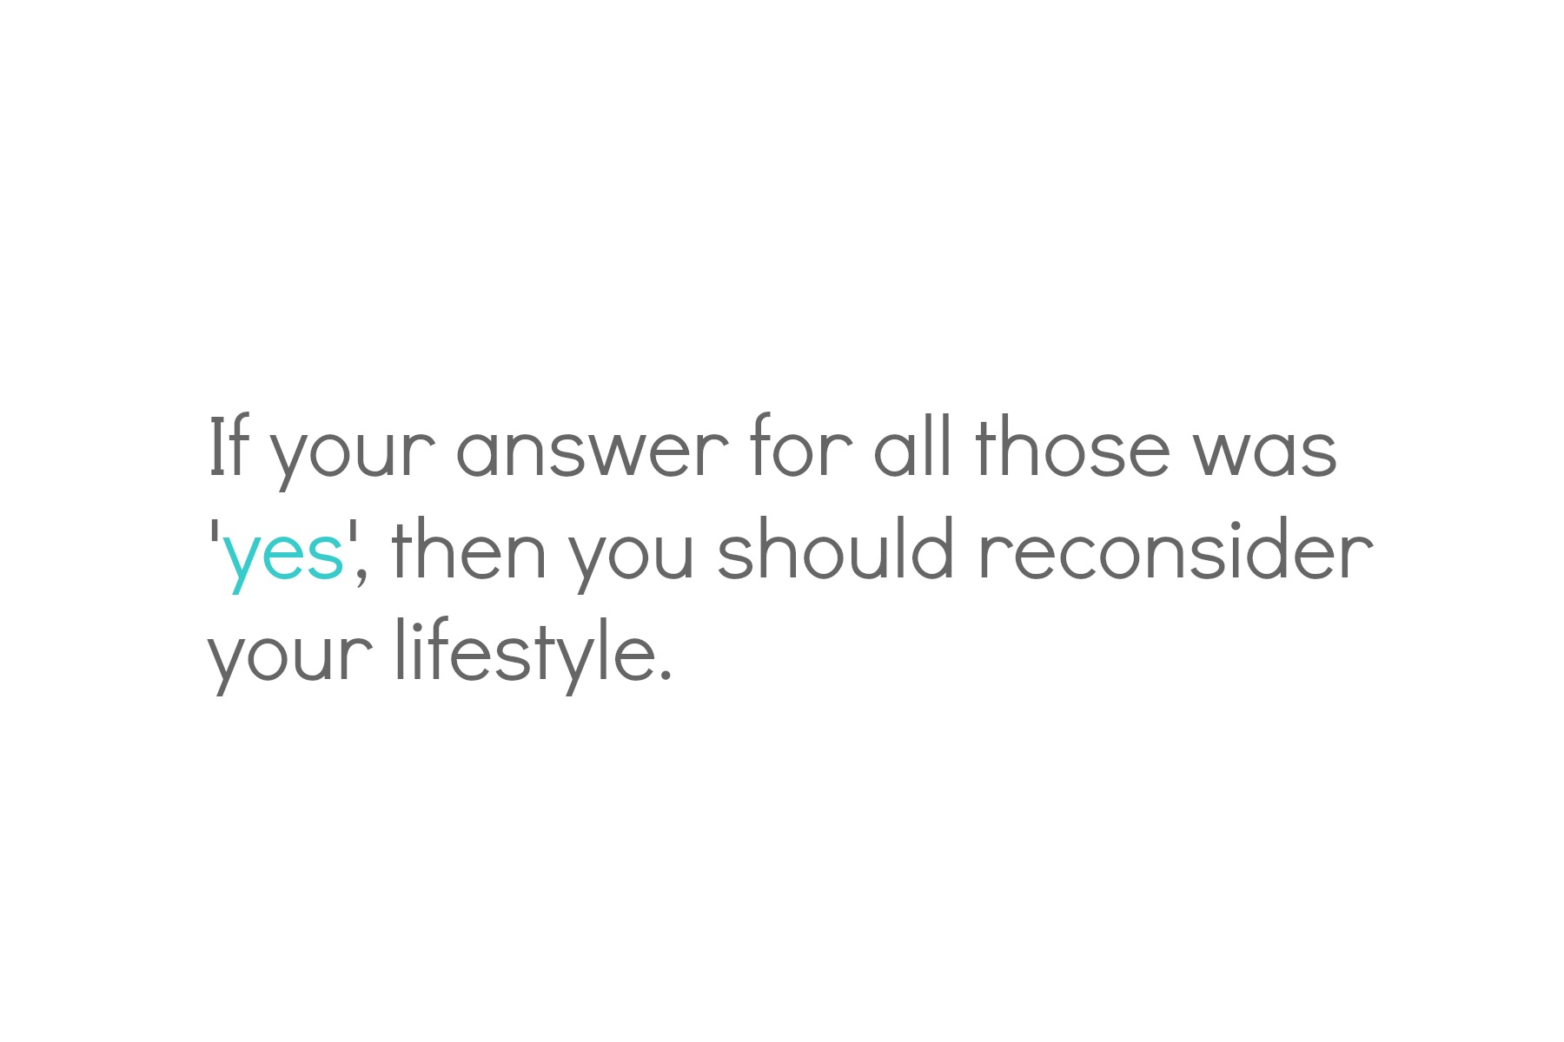
how unhealthy is your life?
Just ask yourself; do you:
Smoke?
Drink a lot of alcohol?
Eat junk food; or/and soda (coke, sprite) more than once a week?
Sleep less than 6 hours everyday?
Are you lacking exercise?

Slide 8

consequences of an unhealthy life
1. CANCER
2. DIABETES
3. HEART PROBLEMS
4. STROKE
5. WEAK BRAIN
6. LOSING MUSCLES
7. OSTEOPOROSIS (fragile bones)
8. BAD MENTAL HEALTH
9. GAINING WEIGHT
10. RUINED IMMUNE SYSTEM

Slide 9
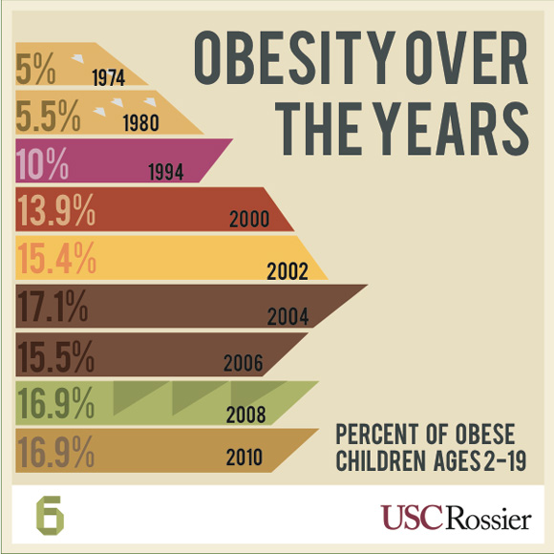
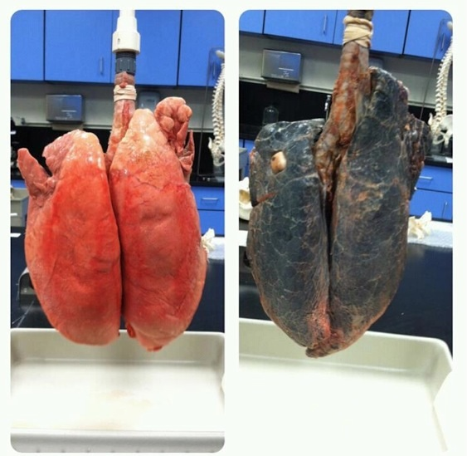
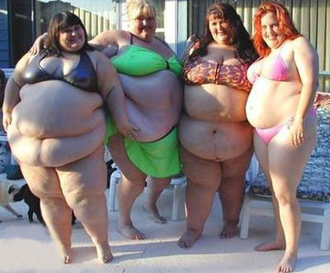
non-smoker
smoker

