Slide 1
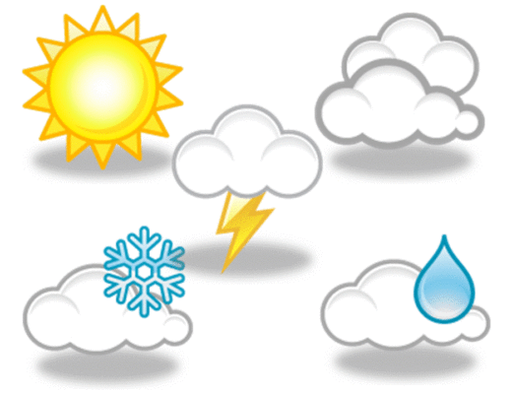
Nature, weather in the Czech Republic and English speaking countries
Name: barbora kouklíková
Class: cr4

Slide 2
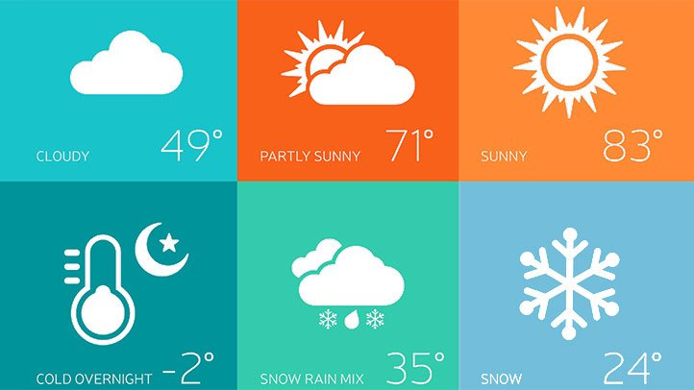
Weather and weather forecast
Weather
Weather forecast

Slide 3
Weather and climate in our country and in English speaking countries
4 seasons (spring, summer, fall/autumn, winter)
Spring – longer days, warmer weather
Summer – high temperature, sunny and muggy days, thunderstorms
Fall – shorter days, cooler weather, it´s windy, rainy, misty
Winter – short days, it´s cold, grey, snow

Slide 4
Weather and climate in our country and in English speaking countries
Affected by the Atlantic ocean
Cool, cloudy, high tempeatures are infreqvent
Spring – calm, cool season
June-August – sunny and warm days (27°C)
September – weather starts to cool down (16°C)
Winter – cool, wet, windy, cloudy

Slide 5
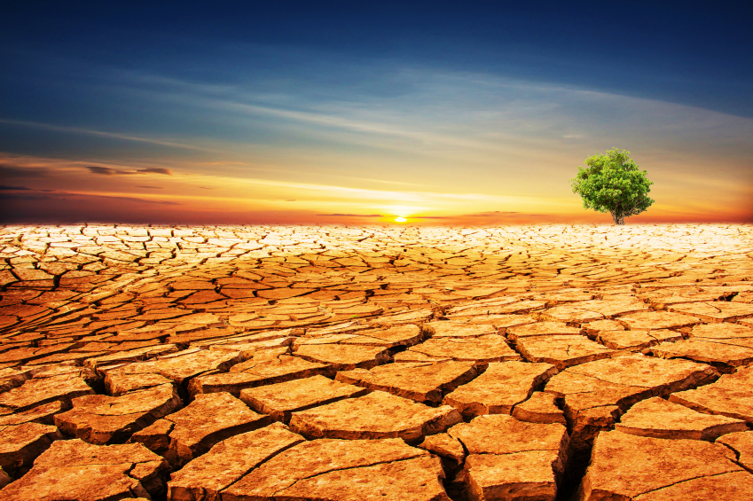
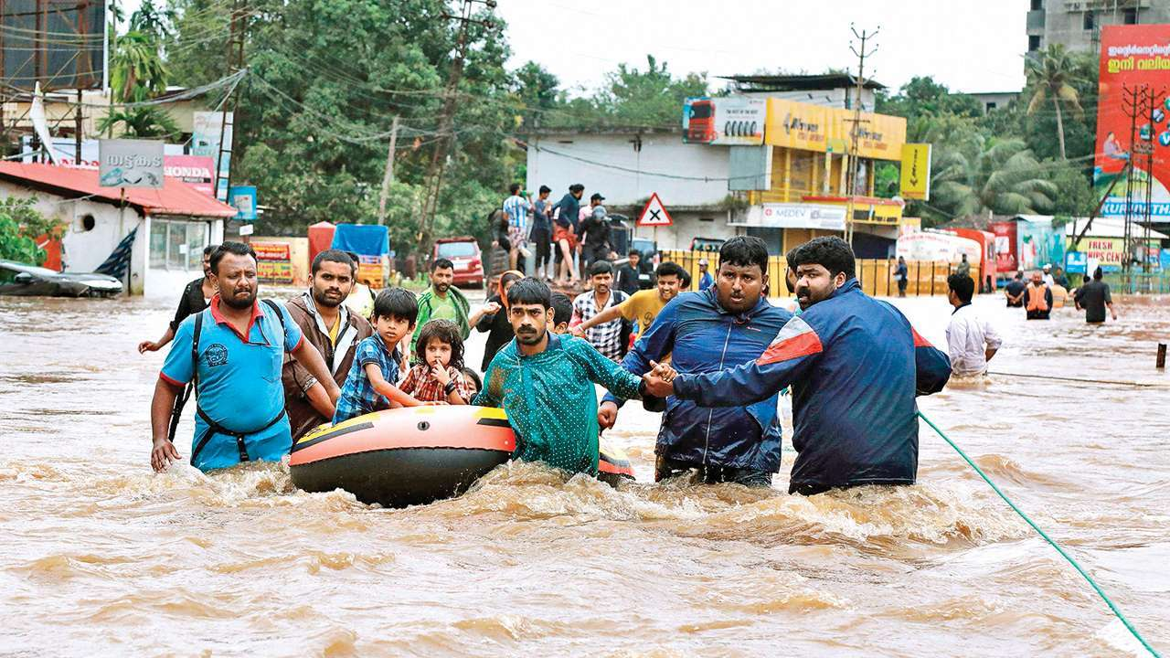
Problems caused by weather
Rains much -> floods
Very hot for long time -> drought
Related to extreme weather

Slide 6
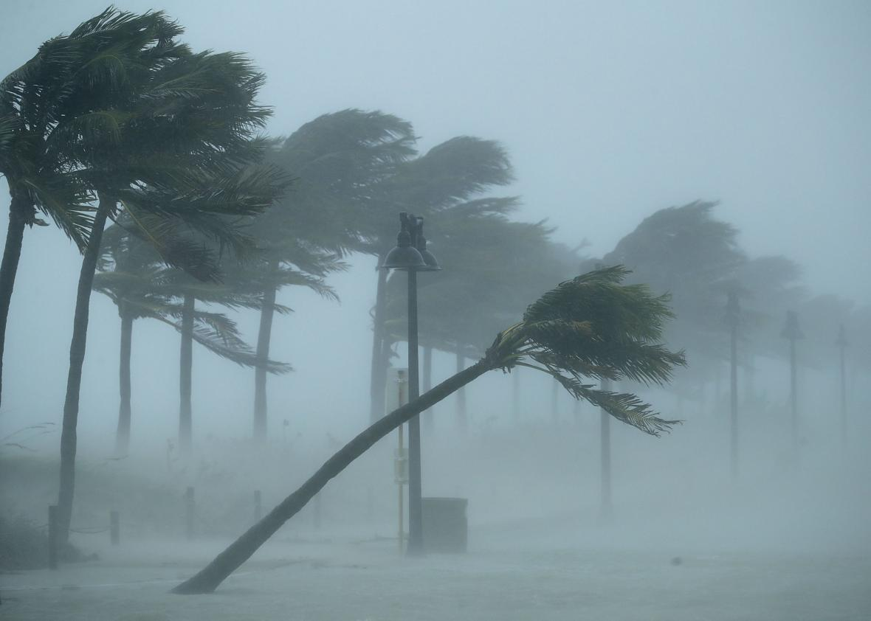
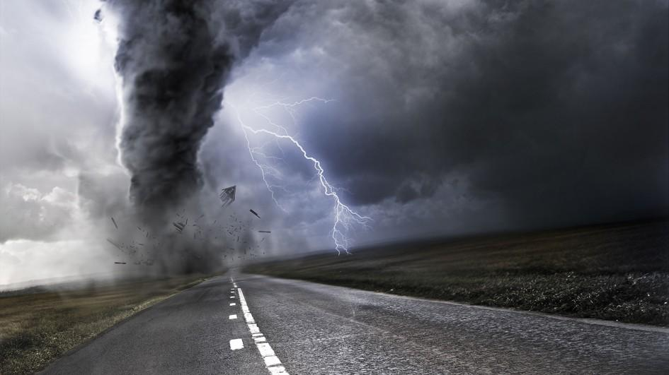
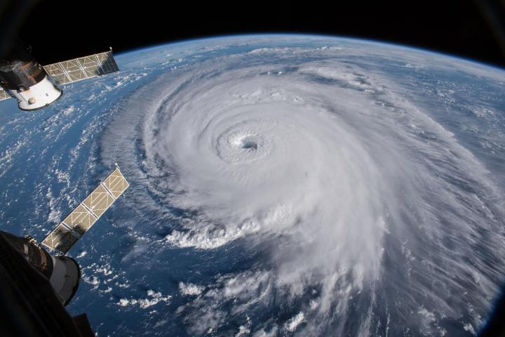
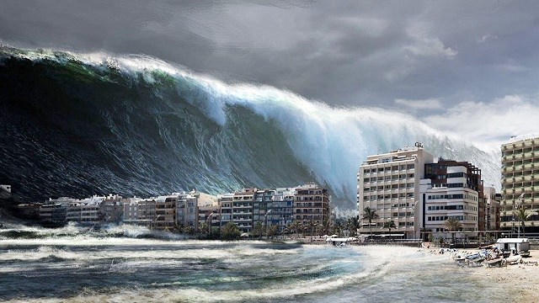
Extreme weather
Hurricane
Tornado
Tsunami

Slide 7
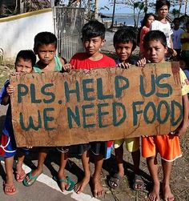
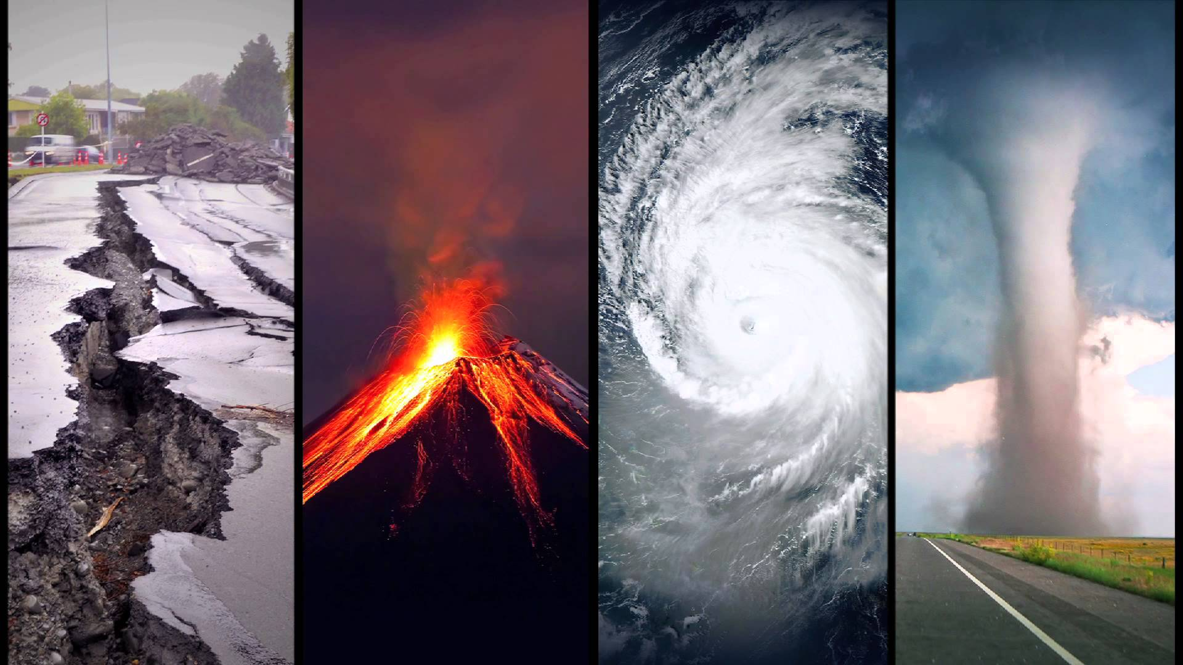
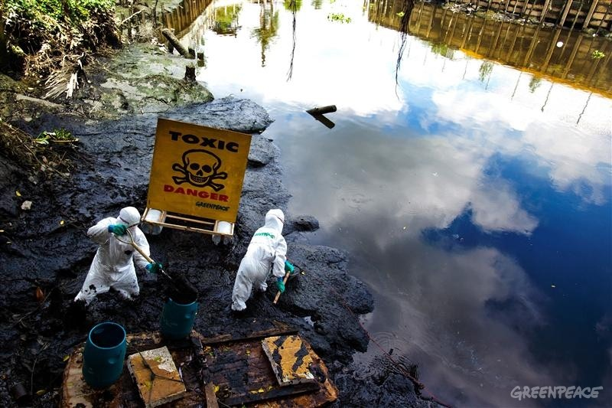
Global problems
Includes and effects the whole world
3 kinds of problem
The first are nature disaster
The second are ozon hole, global warming…
The third are poverty, wars, famine…

Slide 8
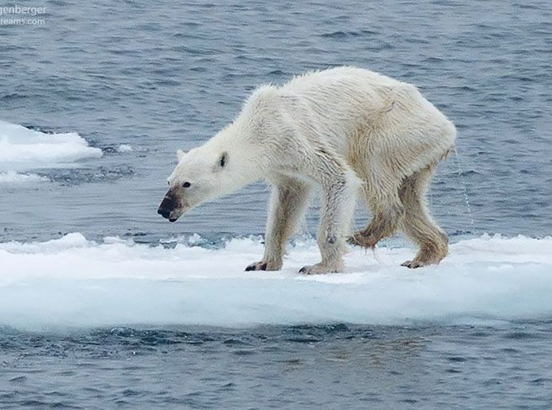
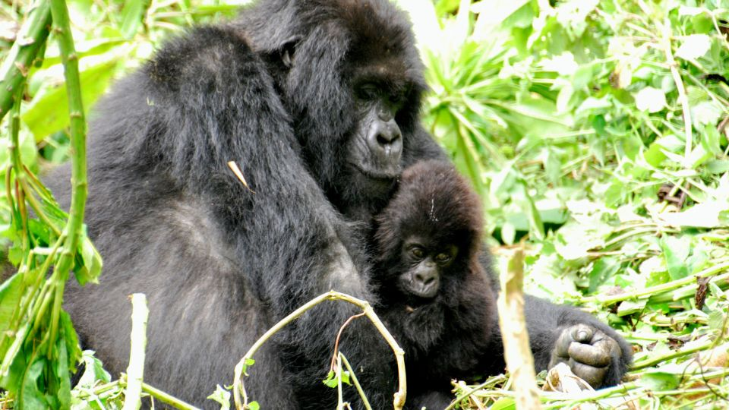
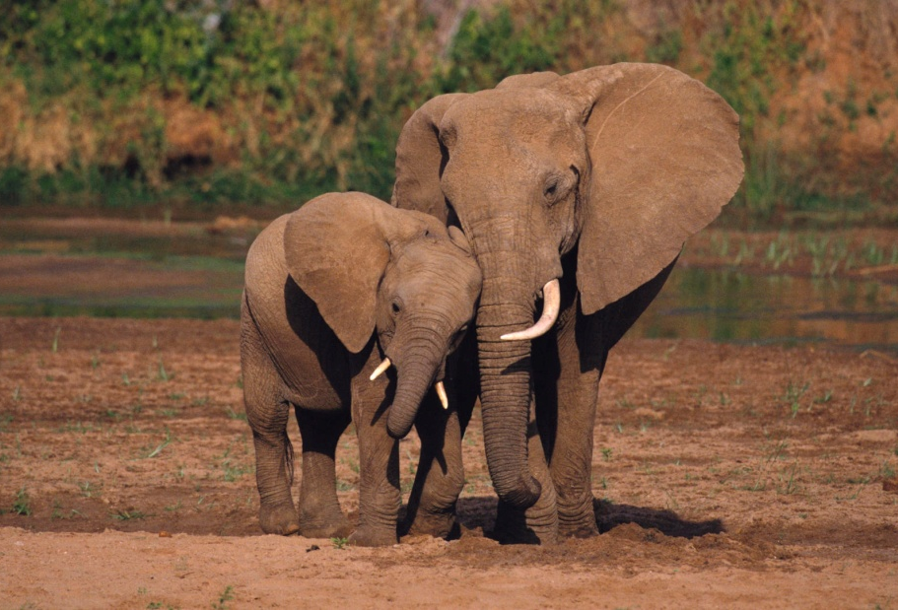
Animals in danger
Extreme weather (tsunami, hurricane, tornado…)
Not enough food, water
Destroying forests and forest fire

Slide 9
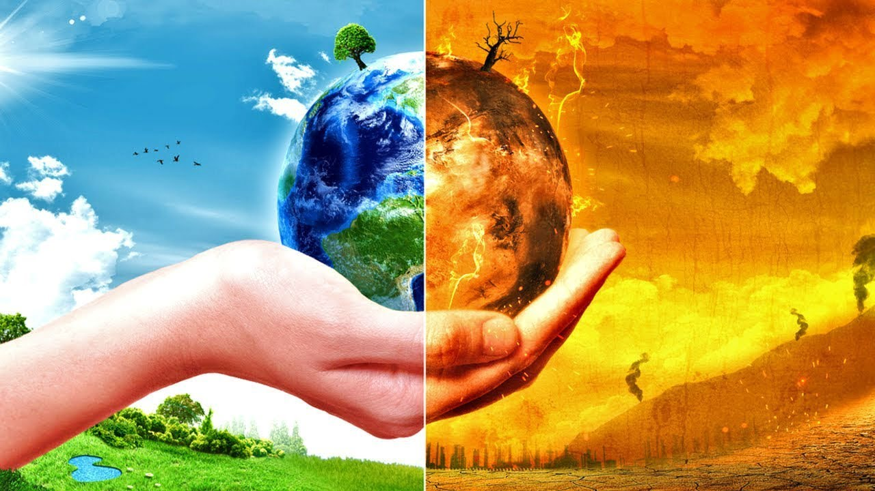
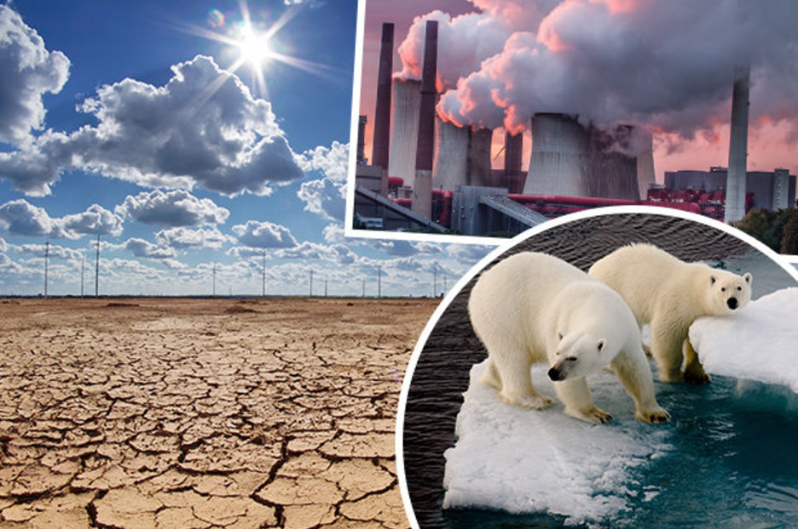
Global warming
Climate change
Caused by humans activity

Slide 10
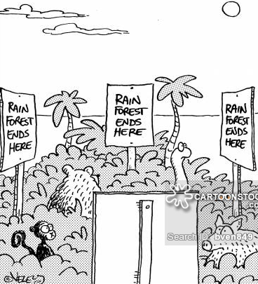
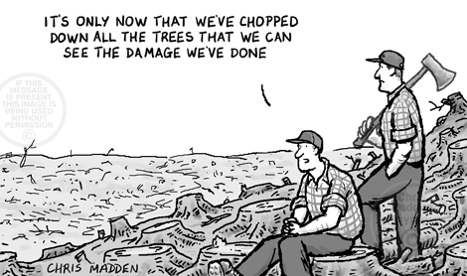
Destroying rainforests
Humans are the main cause
Plants and animals die or must find another forest

Slide 11
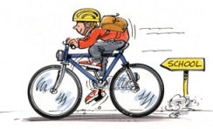
How to help environment
Save energy and water by trning off the lights and water
Go to school/work by bus, bike or walk
Recycle
Make compost

Slide 12
Vocabulary
Weather forecast – předpověď počasí
Muggy – dusno
Thunderstorms - bouřky
Misty – mlhavo
Flood – povodeň, záplava
Drought – sucho
Related – související
Come to be – přichází , vzniká (díky něčemu)
Famine - hladomor
Poverty - chudoba

Slide 13
Thanks for your attention ☺

