Slide 1
Payment, table setting, waiter

Slide 2
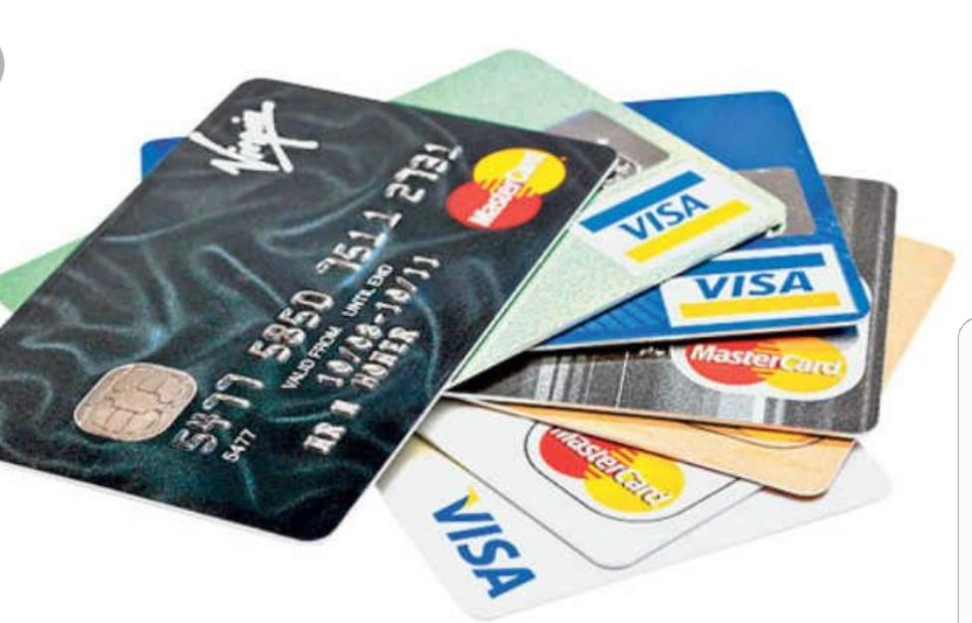
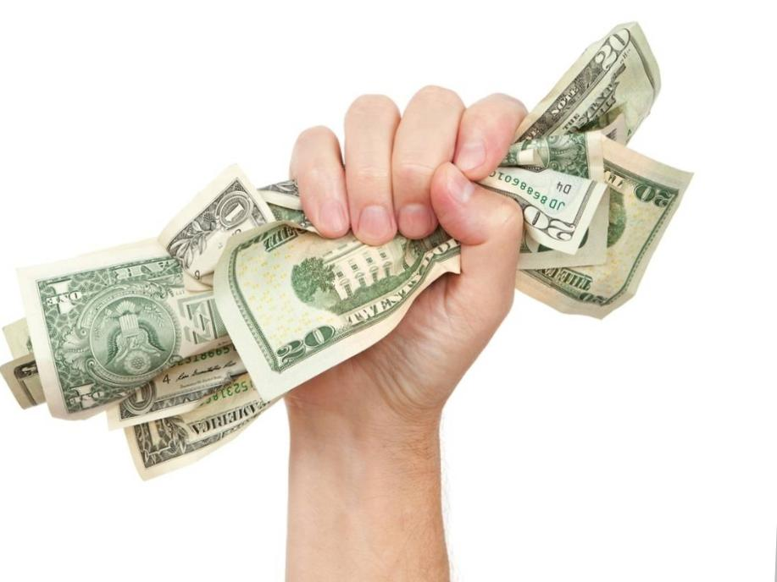
Payment
Kredit card
+ no cash, hurtless pay, fast
- sometimes unavailable, missaply
Cash
+ control, you can give tip,

Slide 3
Table setting
Lots of types (formal, informal, decorative,….)
Etic rules
Specific cutlery
Decoration
Napkins, bibs

Slide 4
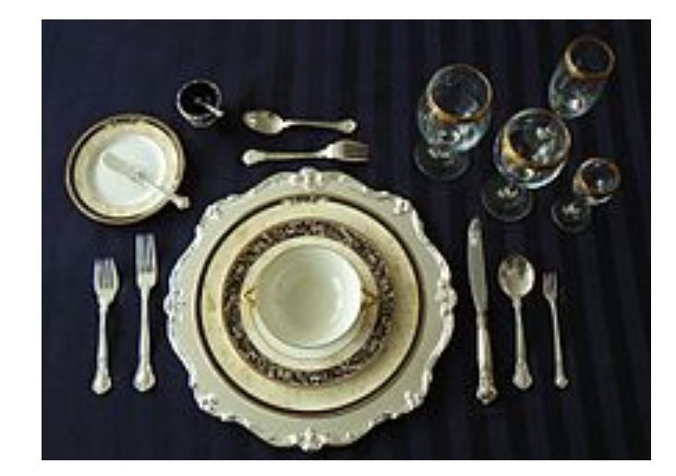
Formal
Utensils are placed inward about 20cm or 8 inches from the edge of the table, with all placed either upon the same invisible baseline or upon the same invisible median line.

Slide 5
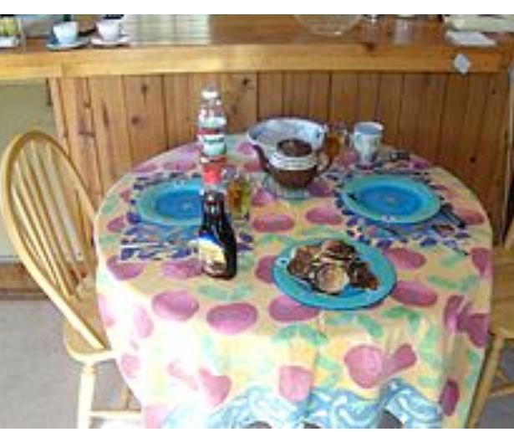
Informal
At an informal setting, fewer utensils are used and serving dishes are placed on the table.

Slide 6
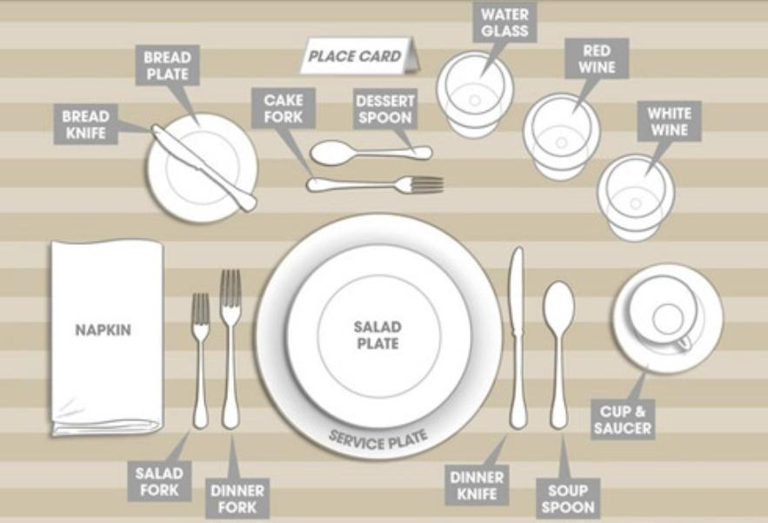

Slide 7
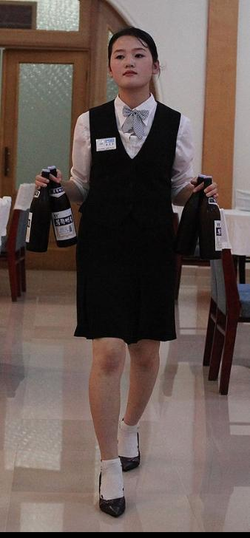
Waiter
Waiting staff are those who work at a restaurant or a bar, and sometimes in private homes, attending customers- supplying them with food and drink as requested.

Slide 8
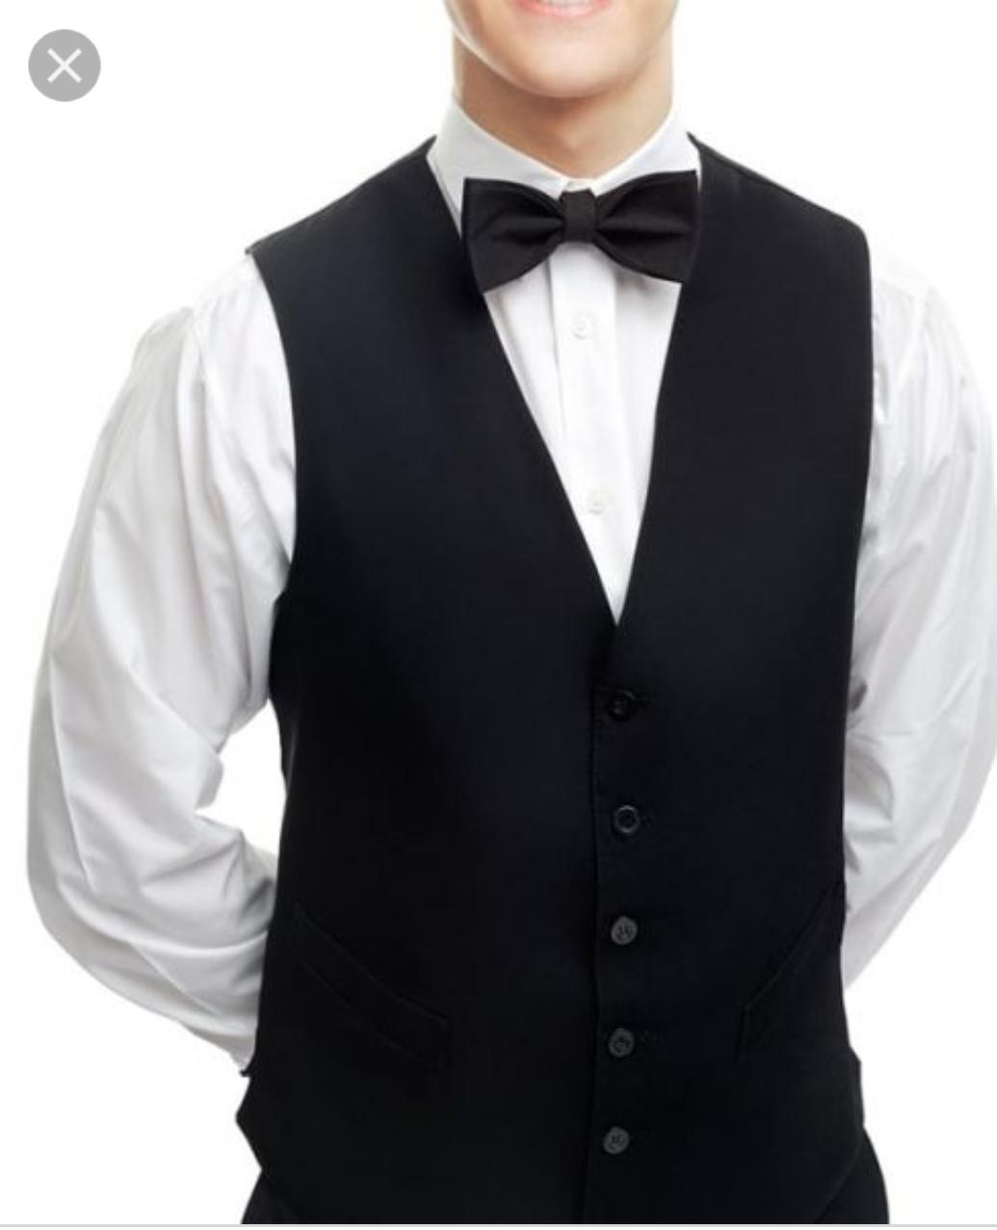
Many restaurants choose a specific uniform for their wait staff to wear. Waitstaff may receive tips as a minor or major part of their earnings, with customs varying widely from country to country.

Slide 9
Tipping
Some restaurants charge an automatic gratuity for larger parties.
Tips average between 15% and 20% of the bill.

Slide 10
Thanks for attention
☺ ☺ ☺

