Slide 1
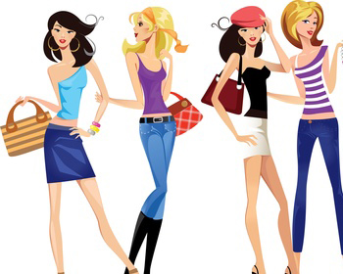
Shopping
Hejná aneta
cr4

Slide 2
Reasons for shopping
Basic need
Prestige
Emotional bond
Replacement
Psychological support
Investment
Good price
A recognized brand
Need
to create an impression
Solidarity
Presents
Dependence for shopping
Fear
Enjoyment

Slide 3
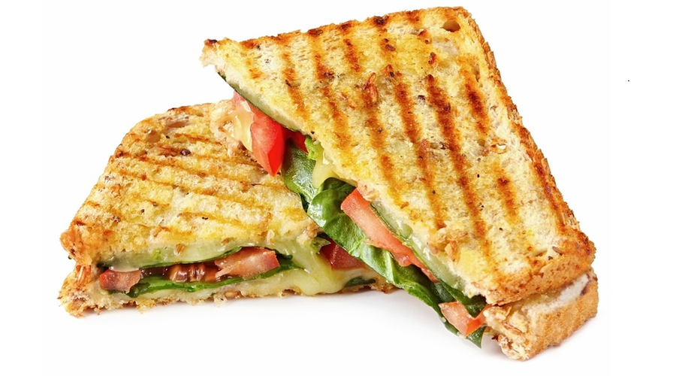
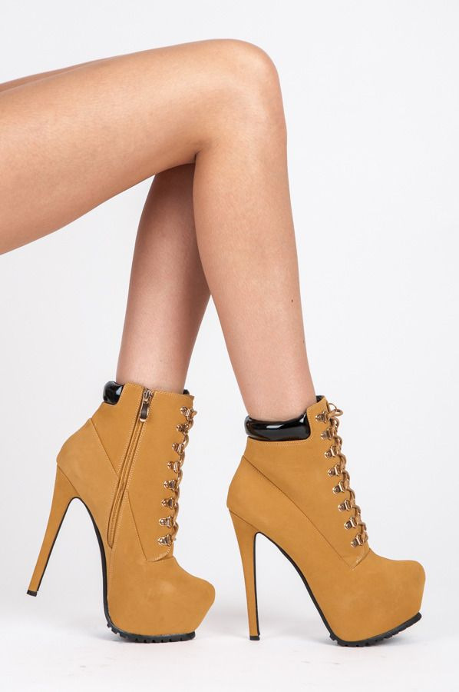
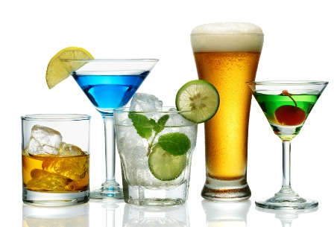
Do you go shopping? What do you like TO buy?
Yes, I go shopping
Most often i buy clothes, food, shoes, drinks

Slide 4
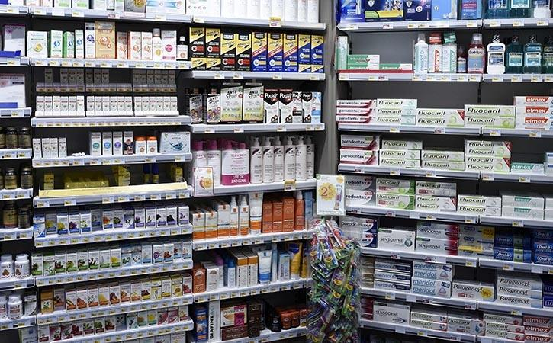
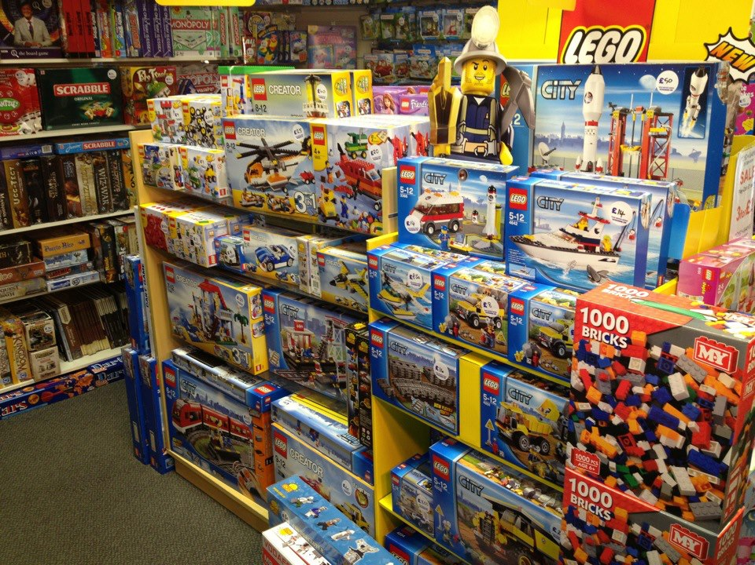
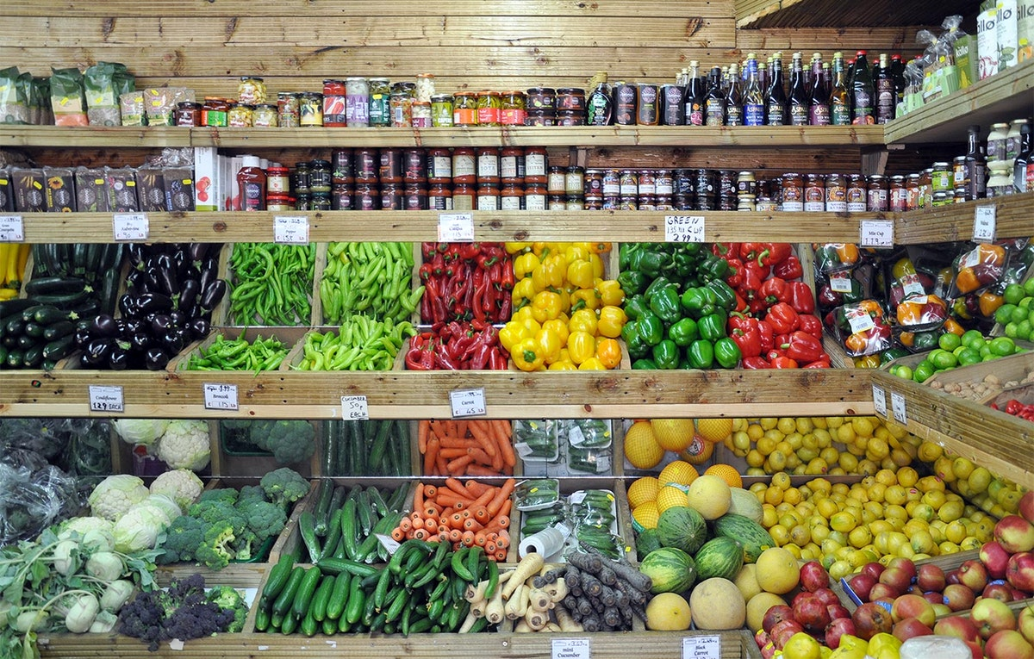
Types of shops
Toy shop
Pet shop
Shoe shop
Chemist‘s shop
Greengrocer‘s shop

Slide 5
Supermarkets
Tesco
Lidl
Albert
Penny
Kaufland
Billa
Advantages: quality food, bigger choice, sales
Disadvantages: expensive

Slide 6
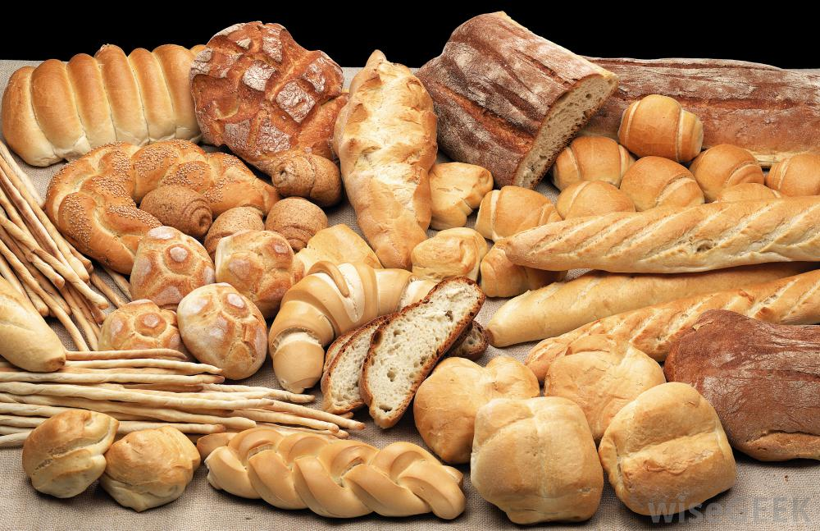
Retails shops
Butcher
Vietnamese grocery shop
Baker
Advantages: low price, pleasant approach
Disadvantages: small choice

Slide 7
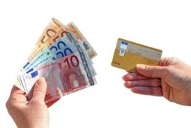
PAYMENt
By card
By cash
I prefer both of them

Slide 8
Sales and discount
Sales - shops hang out poster for sales
- its for all kinds of goods
Discounts – Only FOR SOME KINDS OF GOODS

Slide 9
ONLINE SHOPPING
Advantages
lower price than in stores
You can shop from your house
SaveS time
You can get your goods delivered home
More information about product

Slide 10
Disadvantages
You cant either feel or try Clothes on
The fear of losing the money midway

Slide 11
presents
For my boyfriend, siblings, relatives
Christmas, birthday, name day,…

Slide 12
clothes for different occasions
Clothes according to weather
Spring: jeans, shirt, thin jacket
Summer: Shorts, top, Dress, skirt
Autumn: jeans, jacket, shirt, sweater
Winter: warm jacket, long sleeve Shirt, sweater, jeans

Slide 13
Clothes according to occasion
Working Clothes - used when doing housekeeping, gardening, carpentry work and home repair, it should be loose, comfortable
An interview: you must look professional and polished
For men- Suit jacket and slacks with a shirt and tie, or a sweater and button down
FOR women- blouse and dress pants or a statement dress

Slide 14
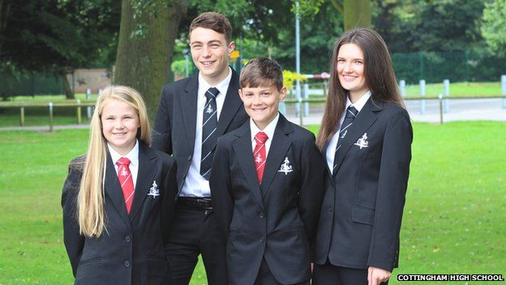
School clothes – england x czech republic
England
School uniform is worn in over 90% of schools in England
Czech republic
You can wear whatever you want
The only rule is that it has to be clean and decent

