Slide 1
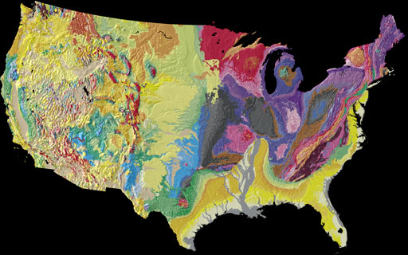
THE UNITED STATES OF AMERICA

Slide 2
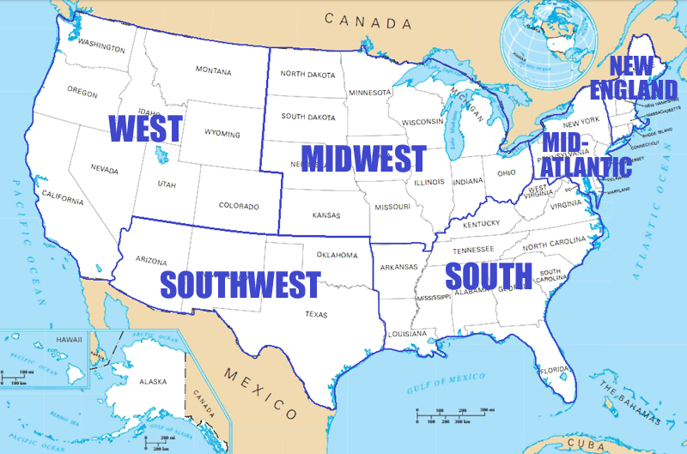
Location
The United States has a long border with Canada to the north.
It borders Mexico to the south.
Its western coastline meets the North Pacific Ocean.
Its eastern coastline meets the North Atlantic Ocean.
It is the third largest country in the world in both area and population.

Slide 3
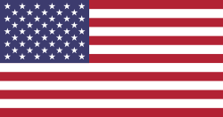
Language: English
Capital city: Washington D. C.
Largest city: New York City
Population: 325,7 milion Area - 9,826,675 sq km Currency – dollar
America consists of 50 states
Each of America’s 50 states has its own government and capital city. State governments have considerable power, for example over education, the health system, criminal law, transportation, etc. However, their laws must comply with the US Constitution and Federal Law. Like Washington D.C., a state capital is not the largest city, by design.

Slide 4
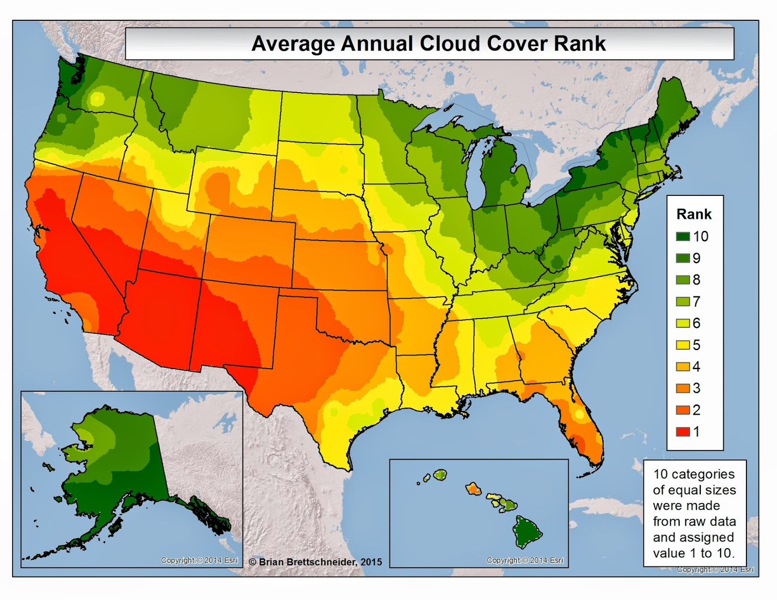
Climate
Weather varies widely across the continental USA, as well as in Alaska and Hawaii. In general terms, summers are hot and humid in the plains and southern states, while the southwest is very hot and quite dry.

Slide 5
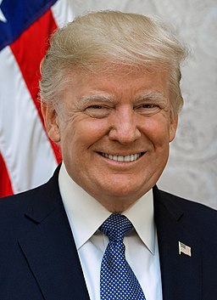
Politic
The United States is a federal republic, a federal district, five territories and several uninhabited island possessions. The states and territories are the principal administrative districts in the country. These are divided into subdivisions of counties and independent cities. The District of Columbia is a federal district that contains the capital of the United States, Washington DC.The states and the District of Columbia choose the President of the United States. Each state has presidential electors equal to the number of their Representatives and Senators in Congress
USA President: Donald Trump,45th president since January 20. 2017

Slide 6
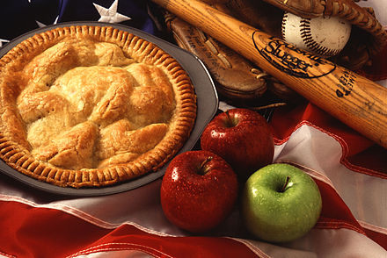
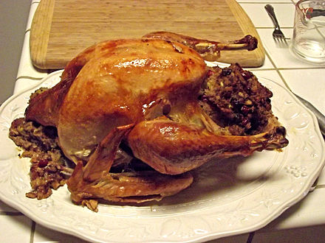
Food
Characteristic dishes such as apple pie, fried chicken, pizza, hamburgers, and hot dogs derive from the recipes of various immigrants.
Apple pie is a food commonly associated with American cuisine.
Roasted turkey is a traditional menu item of an American Thanksgiving.
Mainstream American cuisine is similar to that in other Western countries. Many dishes use indigenous ingredients, such as turkey, venison, potatoes, sweet potatoes, corn, squash, and maple syrup which were consumed by Native Americans and early European settlers

Slide 7
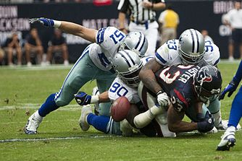
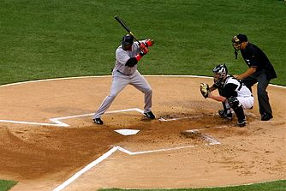
Sports
The most popular American sports are American football, baseball, basketball and ice hockey.
American football is by several measures the most popular spectator sport, the National Football League (NFL) has the highest average attendance of any sports league in the world, and the Super Bowl is watched by millions globally. Baseball has been regarded as the U.S. national sport since the late 19th century, with Major League Baseball (MLB) being the top league.Basketball and ice hockey are the country's next two leading professional team sports, with the top leagues being the National Basketball Association (NBA) and the National Hockey League (NHL).

Slide 8
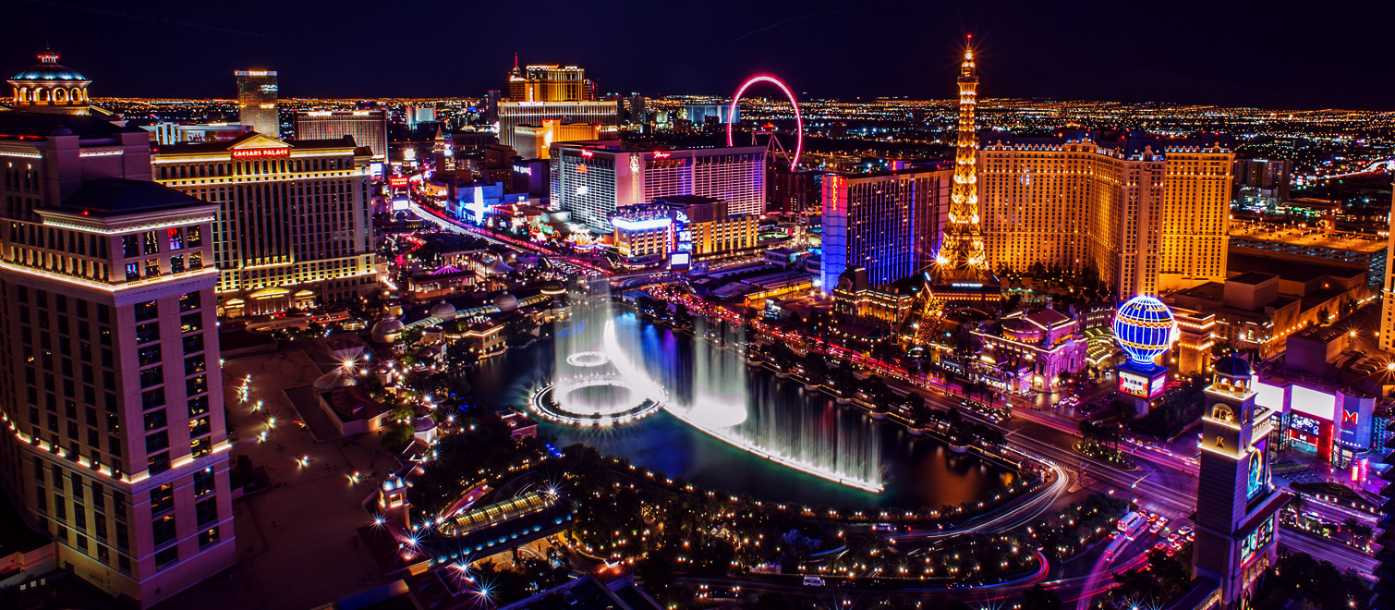
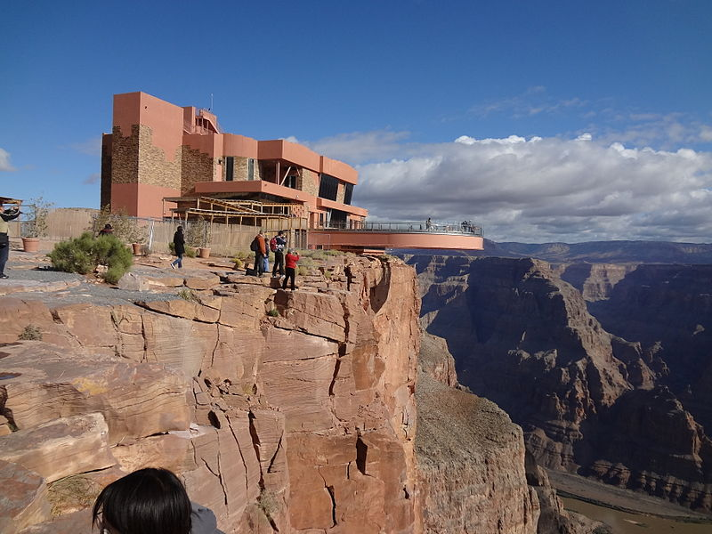
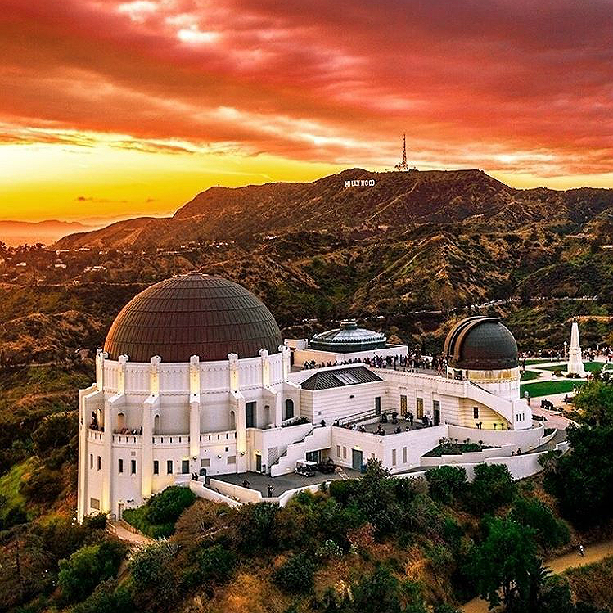
Places of interest
In the USA you can find lots of interesting places and I will mention some of them.
Orlando Florida
National park Grand Canyon
Statue of Liberty
Las Vegas
Yosemite National park
National park Sequoia
Florida Keys
Everglades
Griffith observatory

