Slide 1
Young people
Radka Kováříková HT4

Slide 2
Influence
By friends, peers, social rules, mass media, parents…
Parents - young people need parent’s attention , influence their kids more than they know
Friends - influence in bad way and influence in many good ways

Slide 3
Mass Media - influences on young people mostly in the wrong ways

Slide 4
Problems
Young people face many challenges
They want to try all
Smoking
- widespread problem
- often caused by the peer pressure
- want to fit in group

Slide 5
Bullying
- people may be bullied for no particular reason
Love
- first experiance with love
- when ends it hurts
- you can feel abondoned

Slide 6
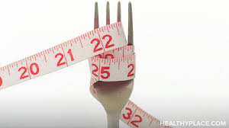
Eating disorders
- including anorexia or bulimia
- secret vomiting, obsess with weight, rapid
weight loss
Young people don’t have enough experience

Slide 7
Generation gap
- misunderstanding between 2 generation
- important is conversation and compromises
Problems with parents
- feel that parents don’t treat them as equal

Slide 8
School problems
- spend a lot of time for studying
- don´t care about grades or school

Slide 9
Dreams and ambition
from some certain age they don’t have pledges (in CR it is 18)
can work, study, travel, recognize foreign land and get new experiences
every young person would like to have a successful life

Slide 10
Vocabulary
Influence - ovlnivňovat, ovlivňování
Widespread - rozšířený
Peer - vrstevník
Particular - určitý
Eating disorders - poruchy příjmu potravy
Equal - rovnoprávný
Misunderstanding - nepochopení
Foreign - cizí

