Slide 1
Young people and their problems

Slide 2
What influences young people?
Media
Friends and family
Famous people and celebrities

Slide 3
Problems
Family problems
divorce
not getting along with parents/siblings
not being good enough for parents
School
stress
disliking school subjects or teachers
bullying

Slide 4
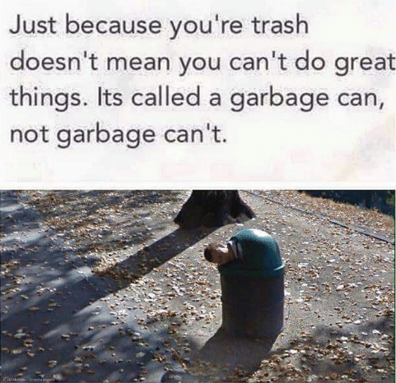
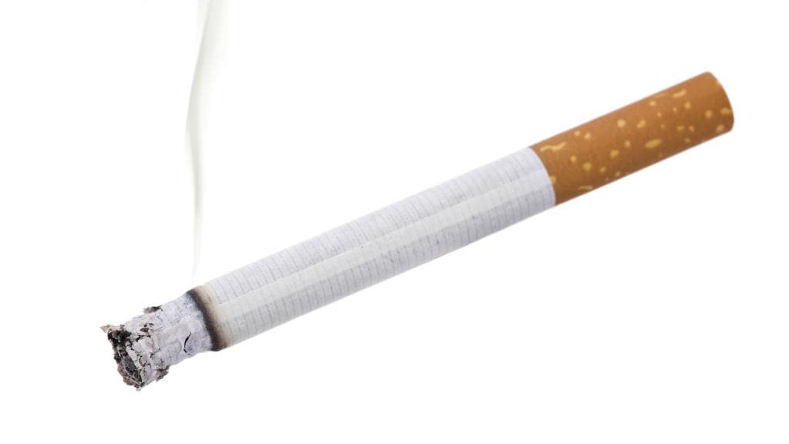
Low self esteem
can be caused by today‘s standards of beauty, social media, family, friends…
often leads to eating disorders
Adapting to society
Alcohol, drugs and smoking
the younger you are, the easier it is to become addicted
Drinking alcohol kills brain cells!!!

Slide 5
Love and friends
break-ups
growing apart from friends
finding new friends

Slide 6
Vocabulary
Bad influence – špatný vliv
Too high expectations – příliš vysoká očekávání
Low self esteem – nízké sebevědomí
Eating disorders – poruchy příjmu potravy
Self harm – sebepoškozování
Adapt to society - přizpůsobit se společnosti
Addiction – závislost
Break up – rozchod

